Slide 1
Computational Analysis of Single-cell Omics Data Workshop
Carissa Chen, Sharon Long, Pengyi Yang
Computational Systems Biology Unit, Children’s Medical Research Institute, Sydney Medical School

Slide 2
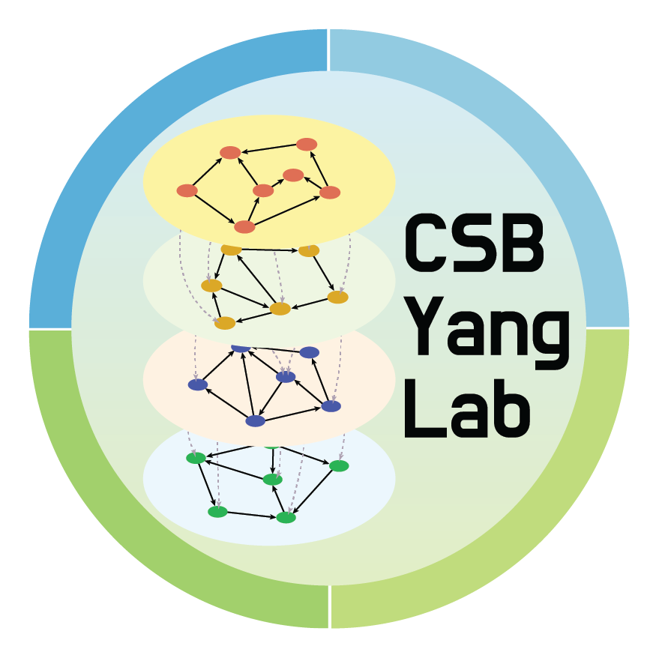
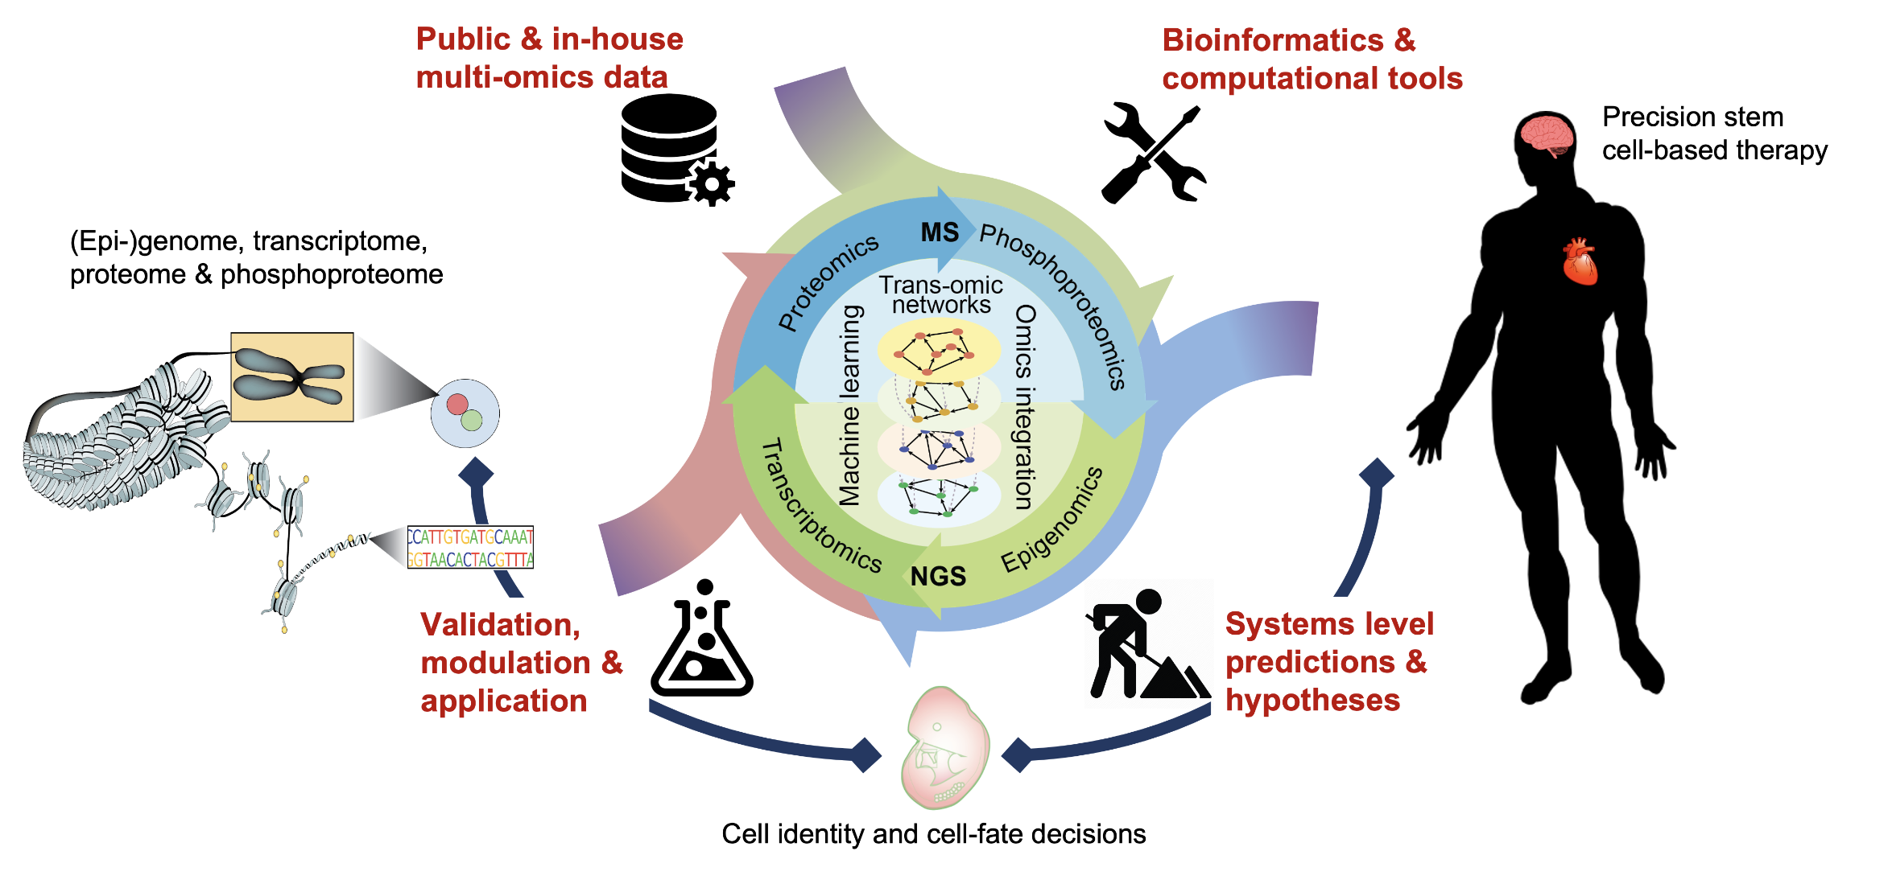
Computational Systems Biology Unit
https://pyanglab.github.io/
Notes:
At our lab, we leverage advances in high throughput bulk and single-cell omics technologies with expertise in machine learning, deep learning, and statistical modelling to develop computational models to understand cell identity and cell-fate decisions in stems cells.
We are a hybrid wet and dry lab where we do both method development, and also design experiments to perturb cell fate together with public data to validate our computational predictions
Ultimately to contribute to stem cell therapy and accurate tissue engineering
Develop computational methods to reconstruct TRNs for modelling cell identity.
Design computational and experimental protocols to modulate TRNs for guiding cell fate-decisions.
Gain knowledge on how do different layers of TRNs coordinately regulate cell identity and cell fate-decisions.
Develop computational framework to assess fidelity of cell conversion for applications such as tissue engineering and stem cell therapy.

Slide 3
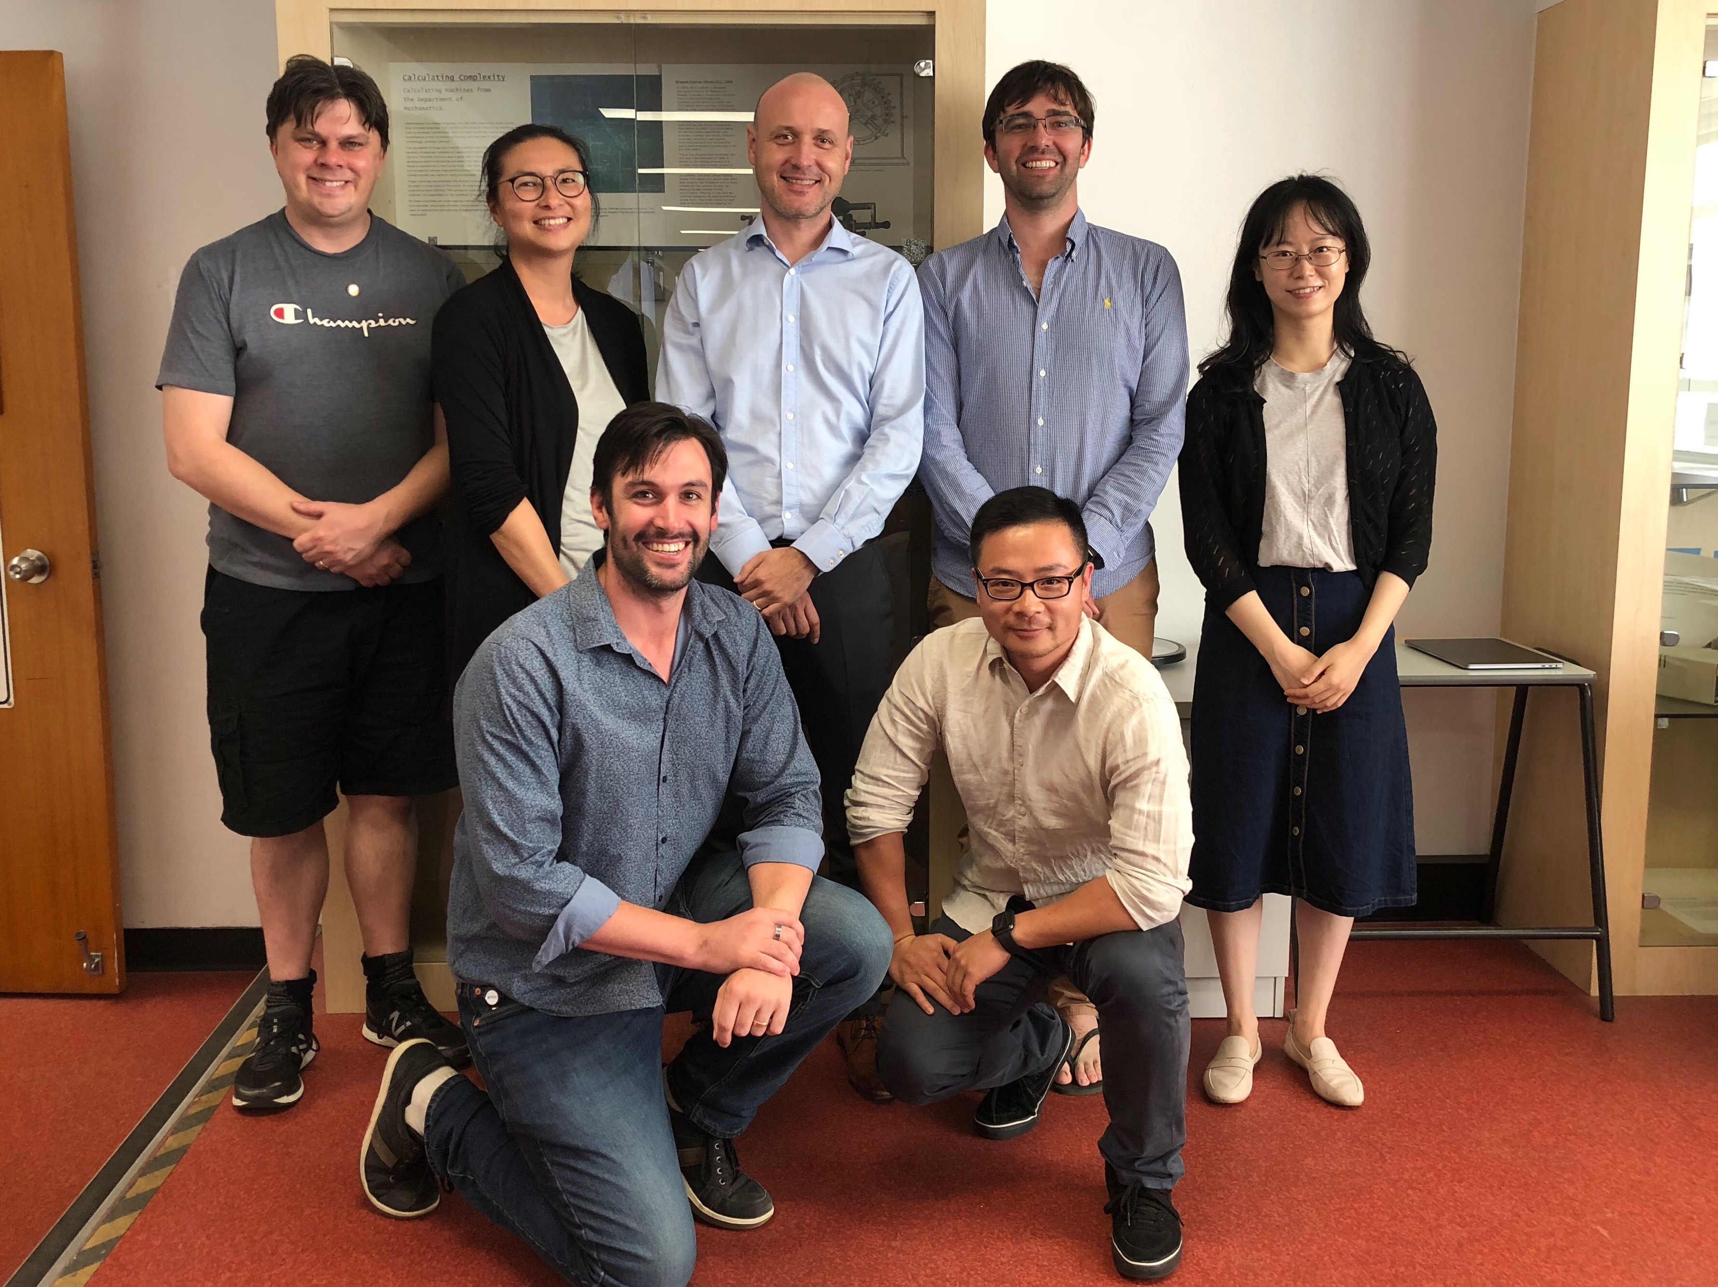
Sydney Precision Bioinformatics Data Science Centre
We share an interest in developing statistical and computational methodologies to tackle the foremost significant challenges posed by modern biology and medicine.
Row 2: A/Prof. John Ormerod; Prof. Jean Yang; Prof. Samuel Mueller; Dr. Garth Tarr; Dr. Rachel Wang
Row 1: Dr. Ellis Patrick; A/Prof. Pengyi Yang
Find out more:
https://www.sydney.edu.au/science/our-research/research-centres/sydney-precision-data-science-centre.html
Shiny apps: http://shiny.maths.usyd.edu.au/
Github: https://github.com/SydneyBioX

Slide 4
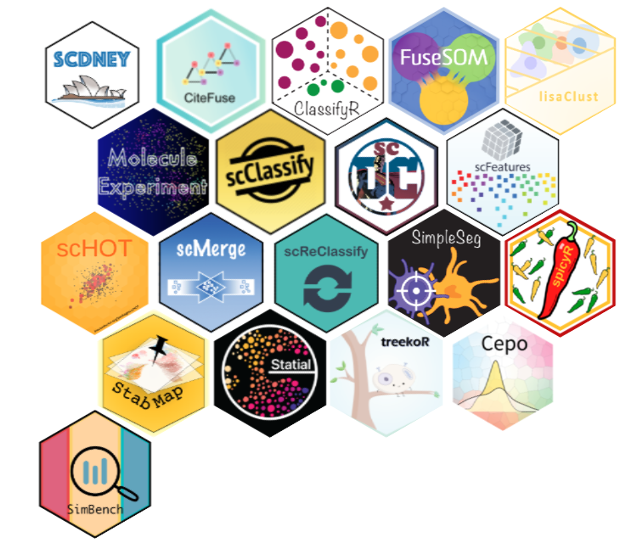
SCDNEY
SCDNEY is a collection of single cell analysis R packages developed by members of the Bioinformatics Cluster within the Sydney Precision Data Science Centre at The University of Sydney. SCDNEY incorporates packages for data integration, cell type annotation, higher order testing and more.
https://sydneybiox.github.io/scdney/

Slide 5
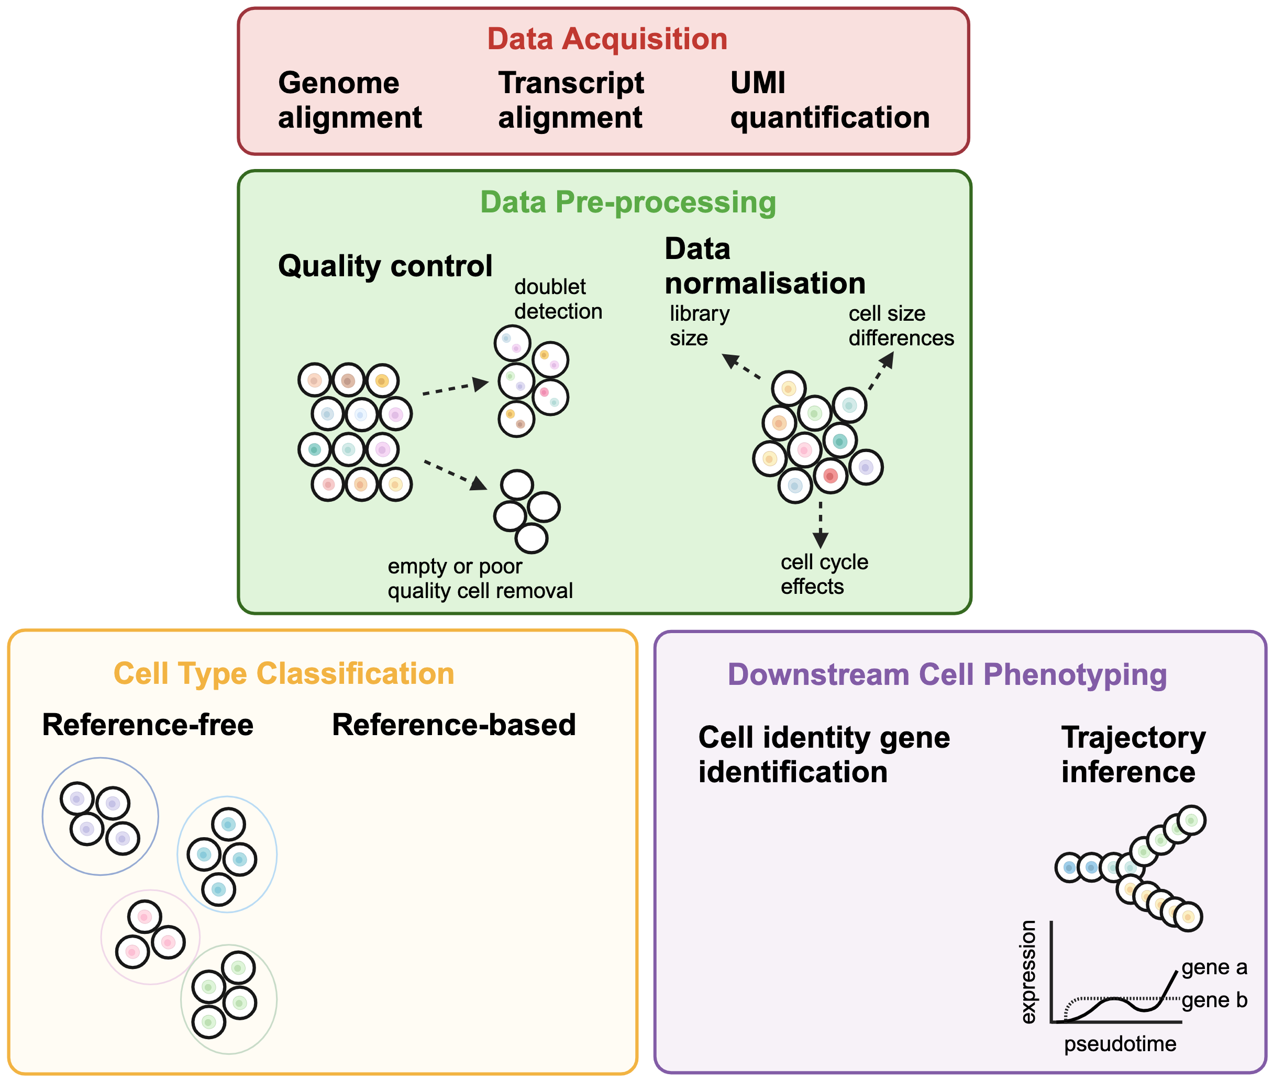

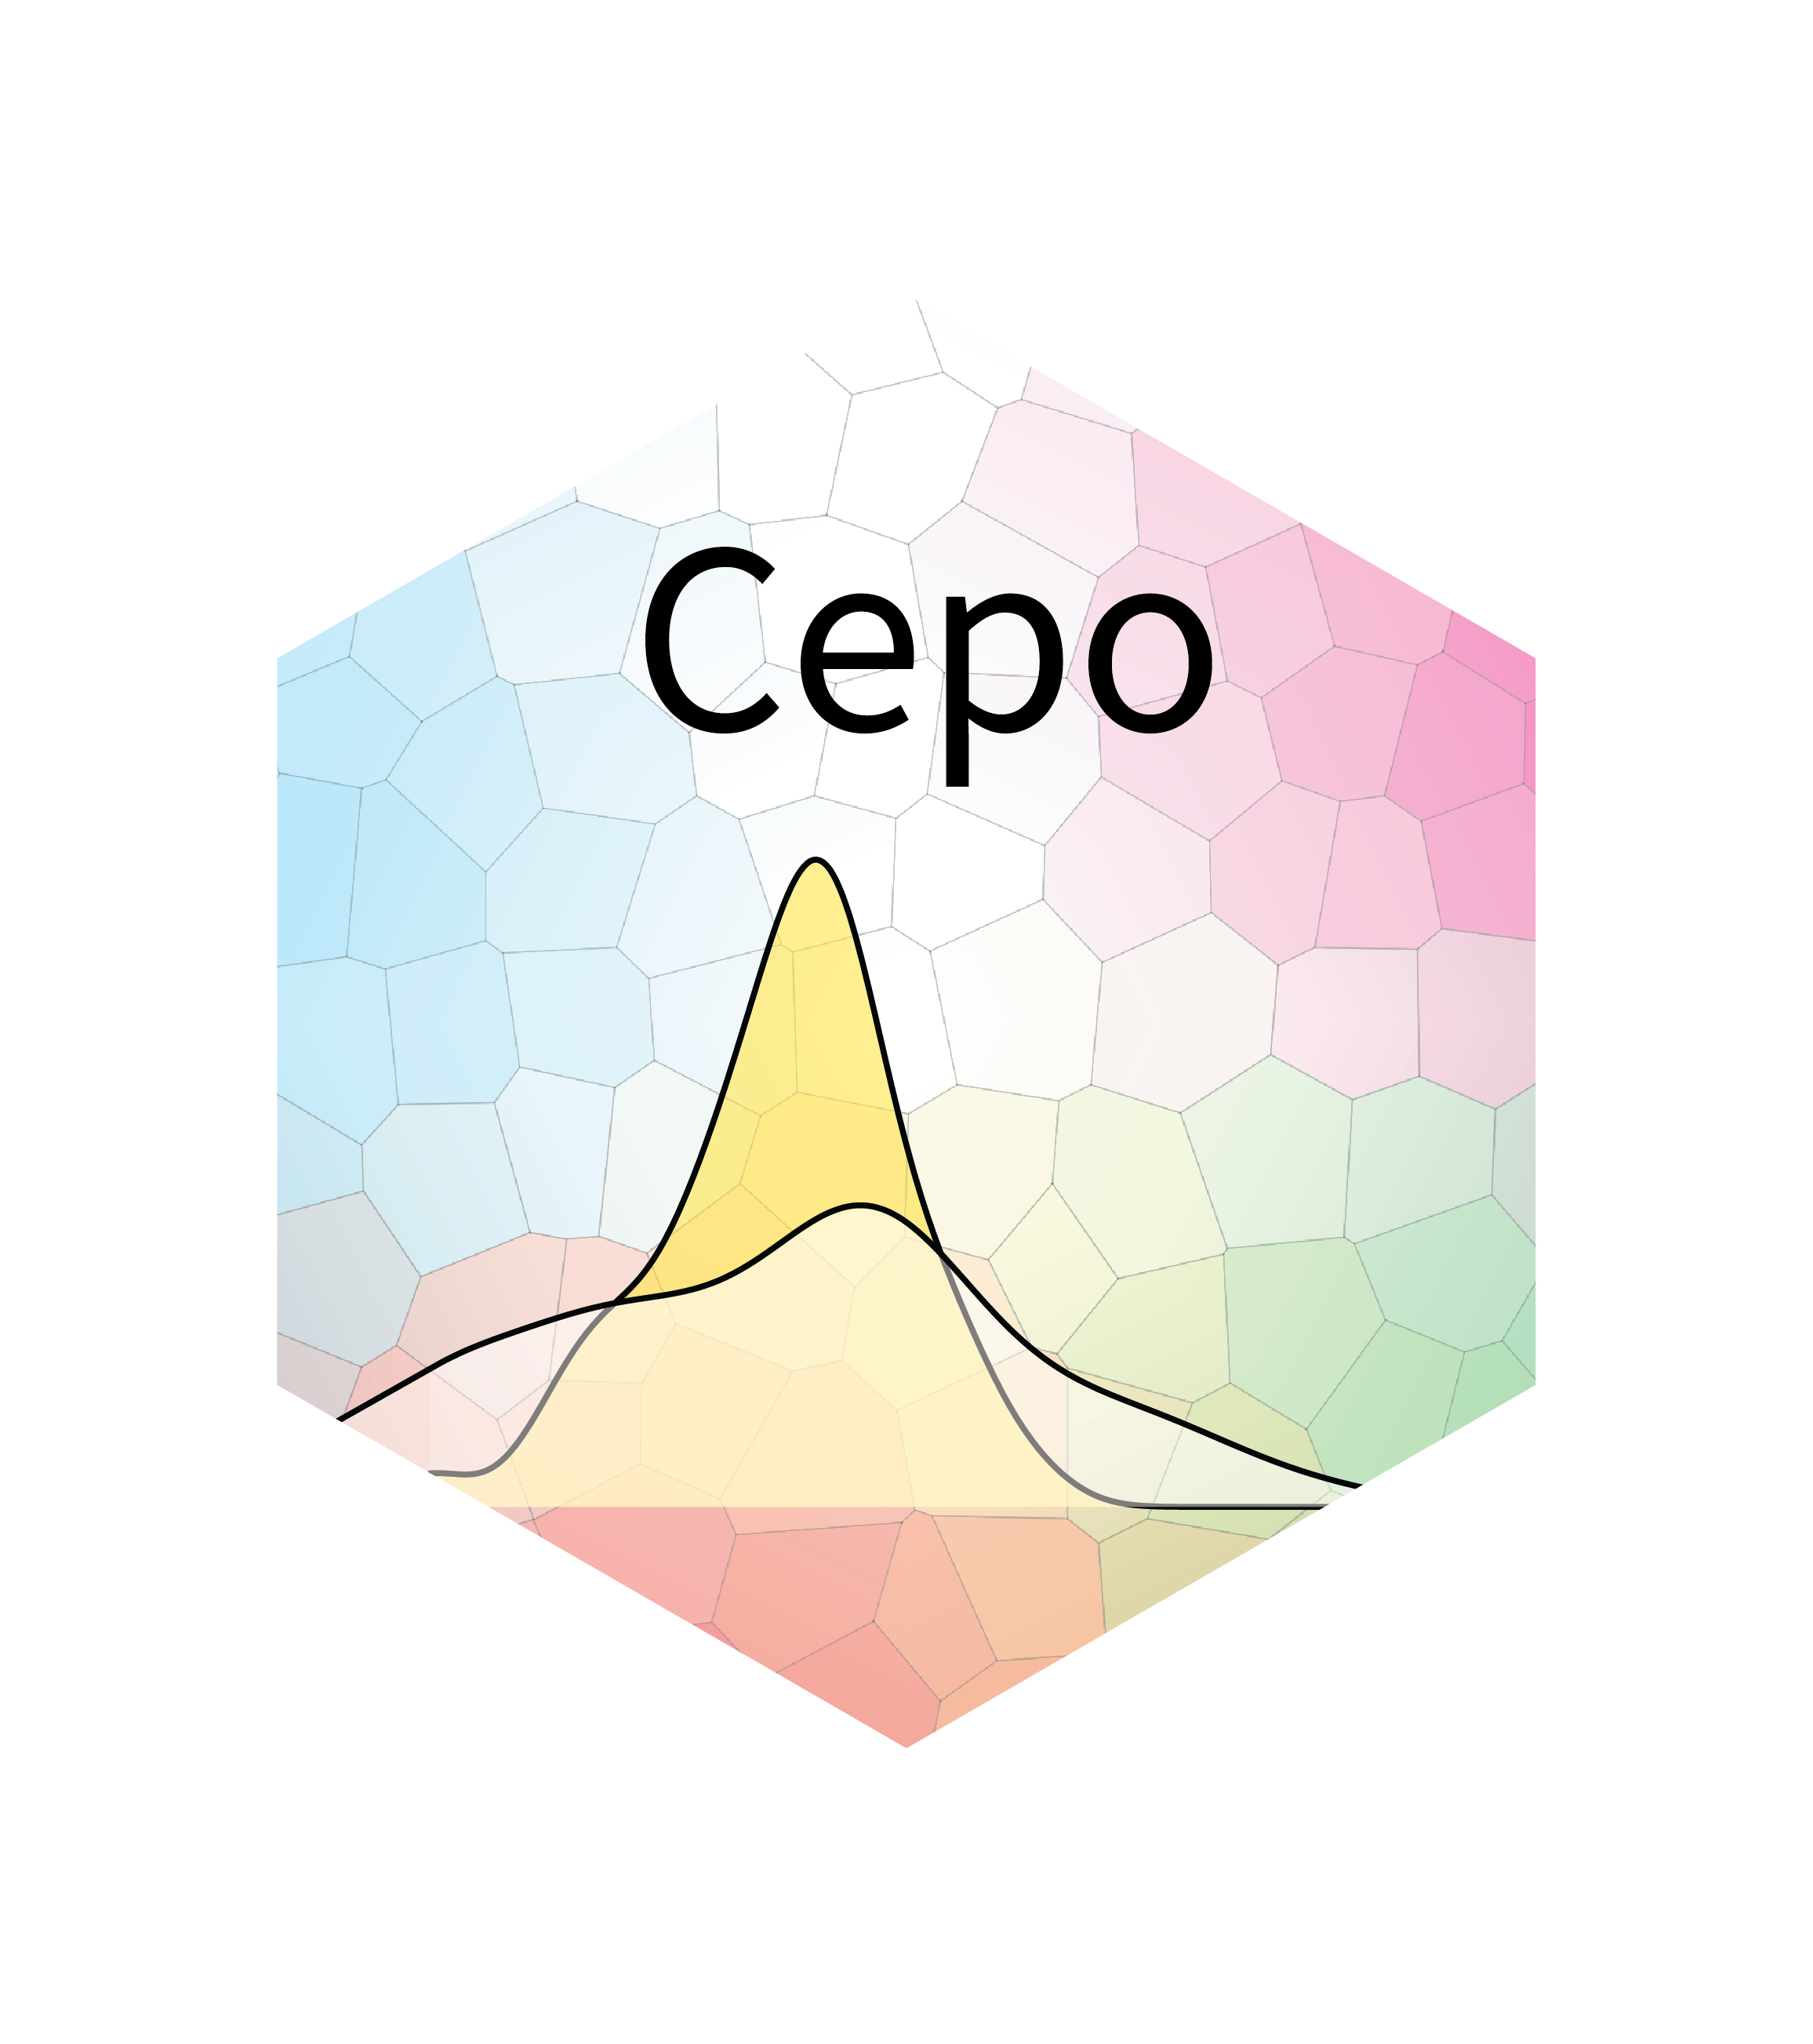
Workshop Overview (Day 1)

Slide 6
Schedule
Setting up: 9:00 – 9:20 Google cloud set up and workshop introduction
Session 1: 9:20 – 10:35 Introduction to single-cell pre-processing
Session 2: 10:50 – 12:00 Basics of single-cell annotation
Session 3: 13:00 – 13:45 Introduction to trajectory analysis
Wrap up: 16:00 – 16:15 Conclusion and wrap up
Session 4: 13:45 – 14:30 Assessing appropriateness of trajectory
Session 5: 14:45 – 15:45 Characterisation of the trajectory
LUNCH: 12:00 – 13:00
BREAK: 10:35 – 10:50
BREAK: 14:30 – 14:45
Notes:
explain each bit one by one
Highlight Breaks and Lunch in BIG words

Slide 7
Configuring Google Cloud
Workshop material
https://carissaynchen.github.io/SCMultiome-CNRS-workshop-R/
https://github.com/carissaynchen/SCMultiome-CNRS-workshop-R/
Google Cloud VM: http://34.77.78.152/
After login, please type the following code in the console:
system(paste0("cp -r /home/gittmp/* ", getwd()))

Slide 8
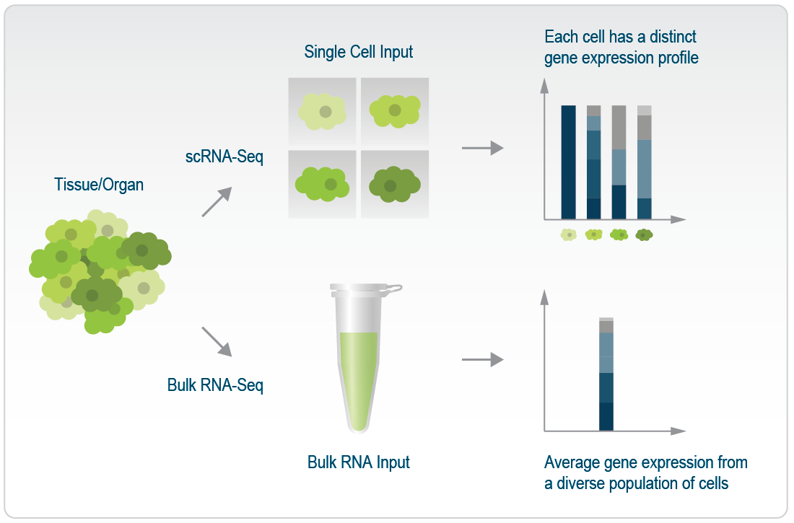
Single-cell RNA-sequencing
Obtain transcriptomic measurement of each single cell
Allow dissection of the heterogeneity within a tissue
Finer resolution of rare/minor subpopulations and track the changes in cellular abundances over time or different treatment conditions

Slide 9
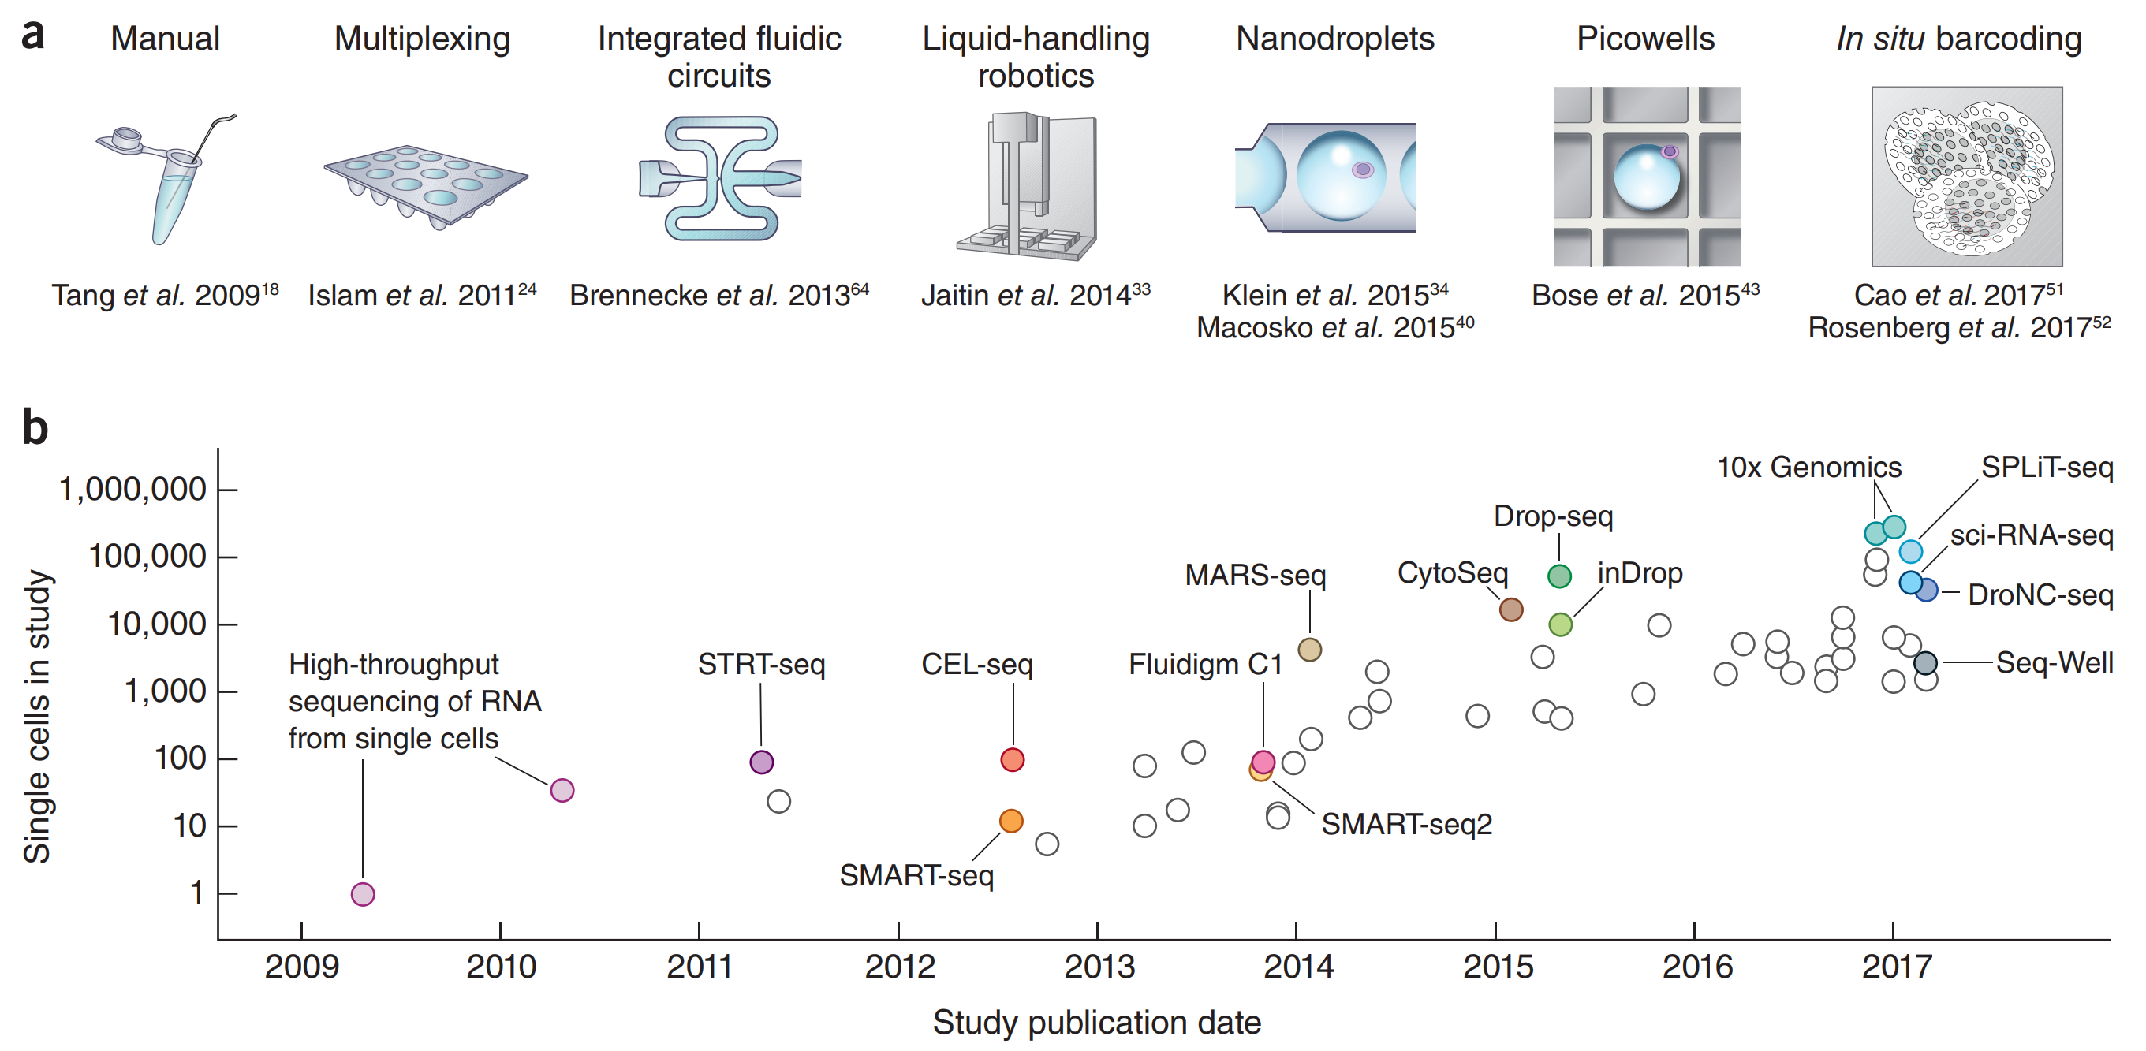
Exponential growth in single cell RNA seq technologies
Svensson et al. Nature Protocols (2018)
Notes:
From this paper by svensson in 2018, which shows the year of publication against the number of single cells profiled in the study, we see that from the first protocol in 2009 to 2017,
we have seen an exponential growth the in scale of scRNA-seq experiments.
At the top, where it shows the evolution of experimental techniques to try and increase the throughput of scRNA-seq, from the first paper in 2009 involved manually picking a single mouse blastomere to the acquired capability to multiplex and adopting a microfluidic system which made a huge leap in the scale of a typical experiment
Rapid growth in single cell technology, measured by how may cells have been sequenced in a study – exponential growth
First paper came out in 2009 – manually pick out one cell and do high through put sequencing
4 years later, with the microfluidc system smartseq that you can get up to more than 50 cells
Smart-seq and C1 are full length protocols which means you can many more reads per cell but not as many cells in terms of bang for buck.
Next leap comes with the droplet technologes – where you can go into 10 of thousands of cells

Slide 10
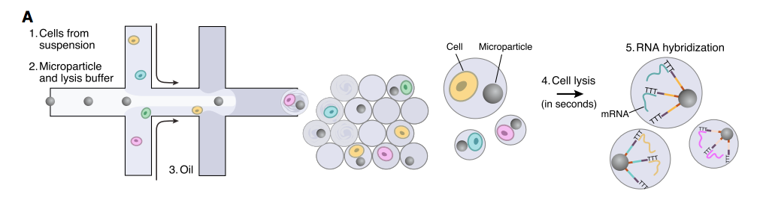
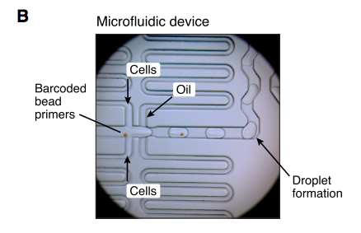
Droplet based technologies are now dominating
Macosko et al. Cell (2015)
10X Genomics is a commercial provider of droplet based scRNAseq platform
Notes:
As we’re probably all familiar, 10X is the most commercialized and convenient platform of droplet-based scRNA-seq where you incapsulate single cells in individual droplet emulsions
Within each droplet, it should contain only a single cell and a single barcode for the cell, reagents for cell lysis and cDNA synthesis
Describe droplets
Dropseq is the academic version
10X Genomics is a tech unicorn – recent round of fund raising valued it at just over $1 billion

Slide 11
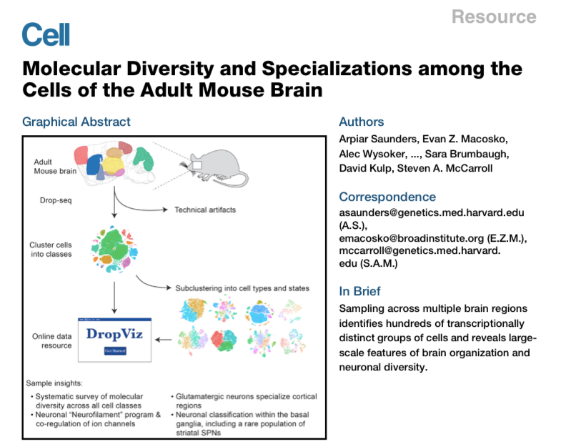
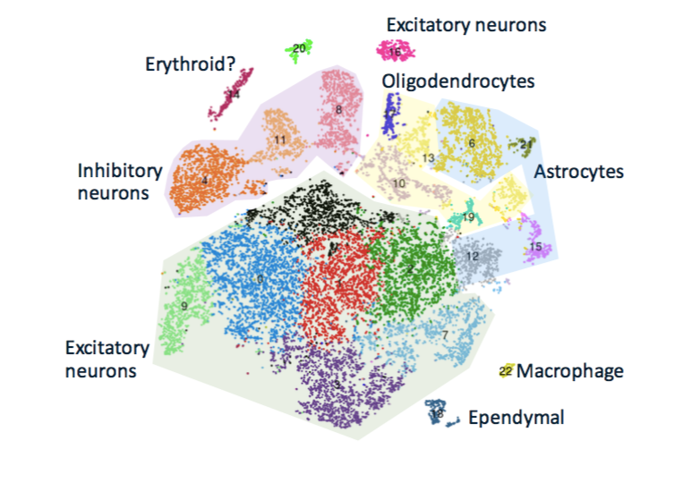
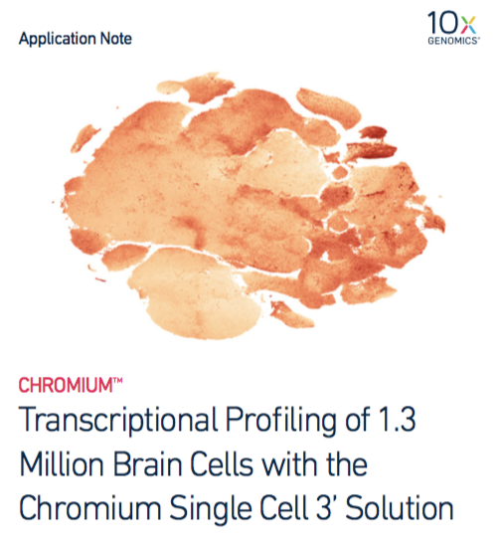
scRNAseq experiments can generate more than 1 million cells
690,000 individual cells from 9 regions of adult mouse brain
Saunders et al. Cell (2018)
Notes:
Previous graph that I showed you stopped at 2017, experiments can now hit 1 million cells
complexity increases with cells and tools
multiple batches
introduces data challenges

Slide 12
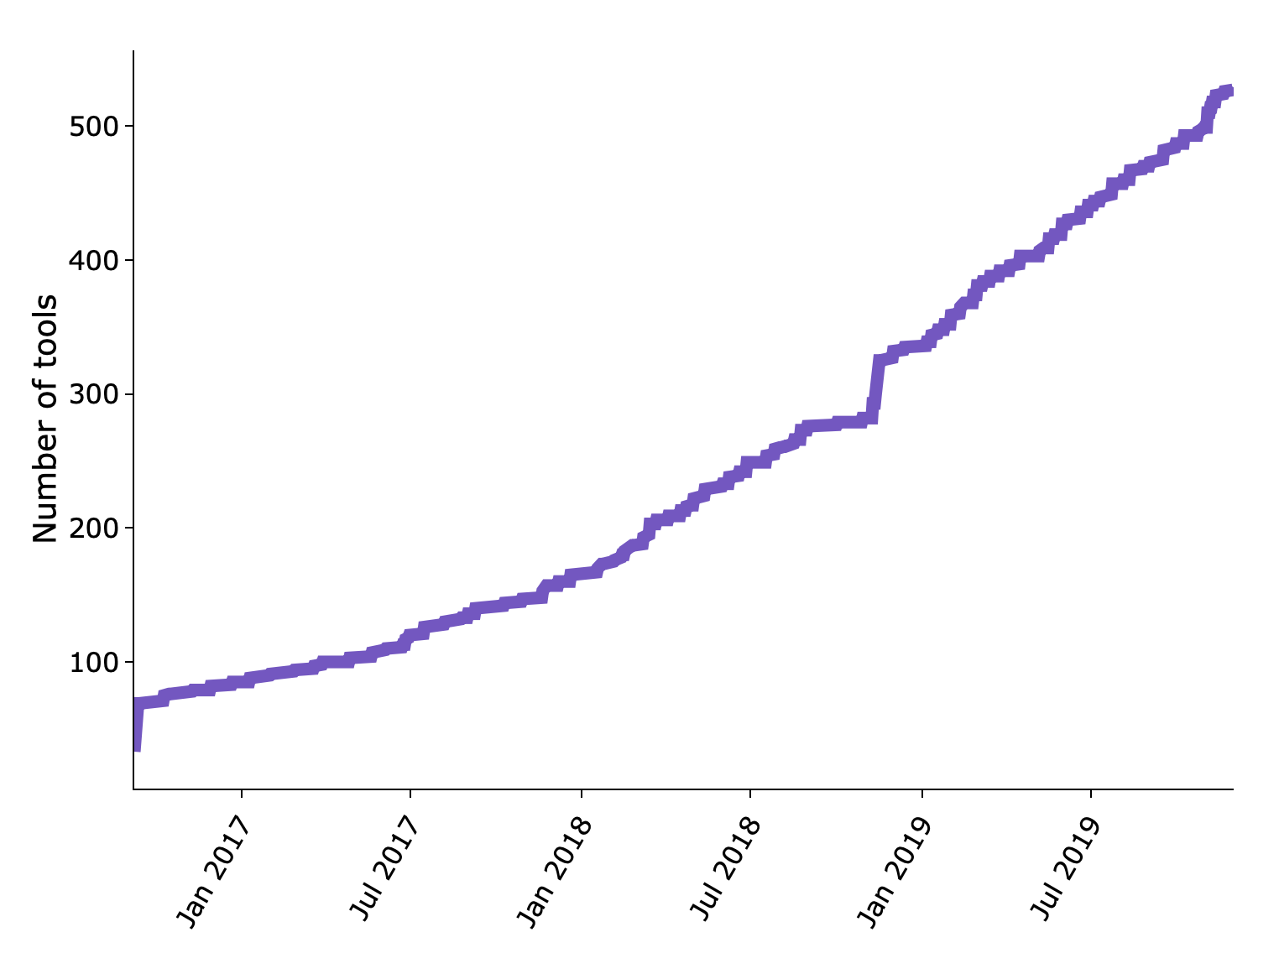
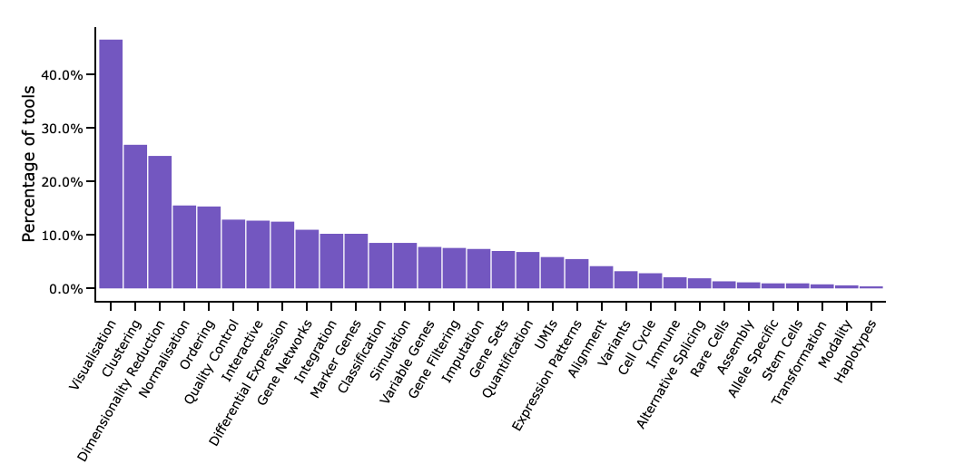
Number of scRNAseq tools also increasing rapidly
Downloaded from www.scrna-tools.org
Notes:
Rapid growth of computational tools, whilst not exponential, you can see there’s a huge demand for visualization of data, clustering and dimensionality reduction tools to address the challenges that come with pre-processing and analysing such complex data

Slide 13
Session 1: 9:50 – 11:05
Introduction to single-cell pre-processing

Slide 14

Workshop Overview (Day 1)

Slide 15
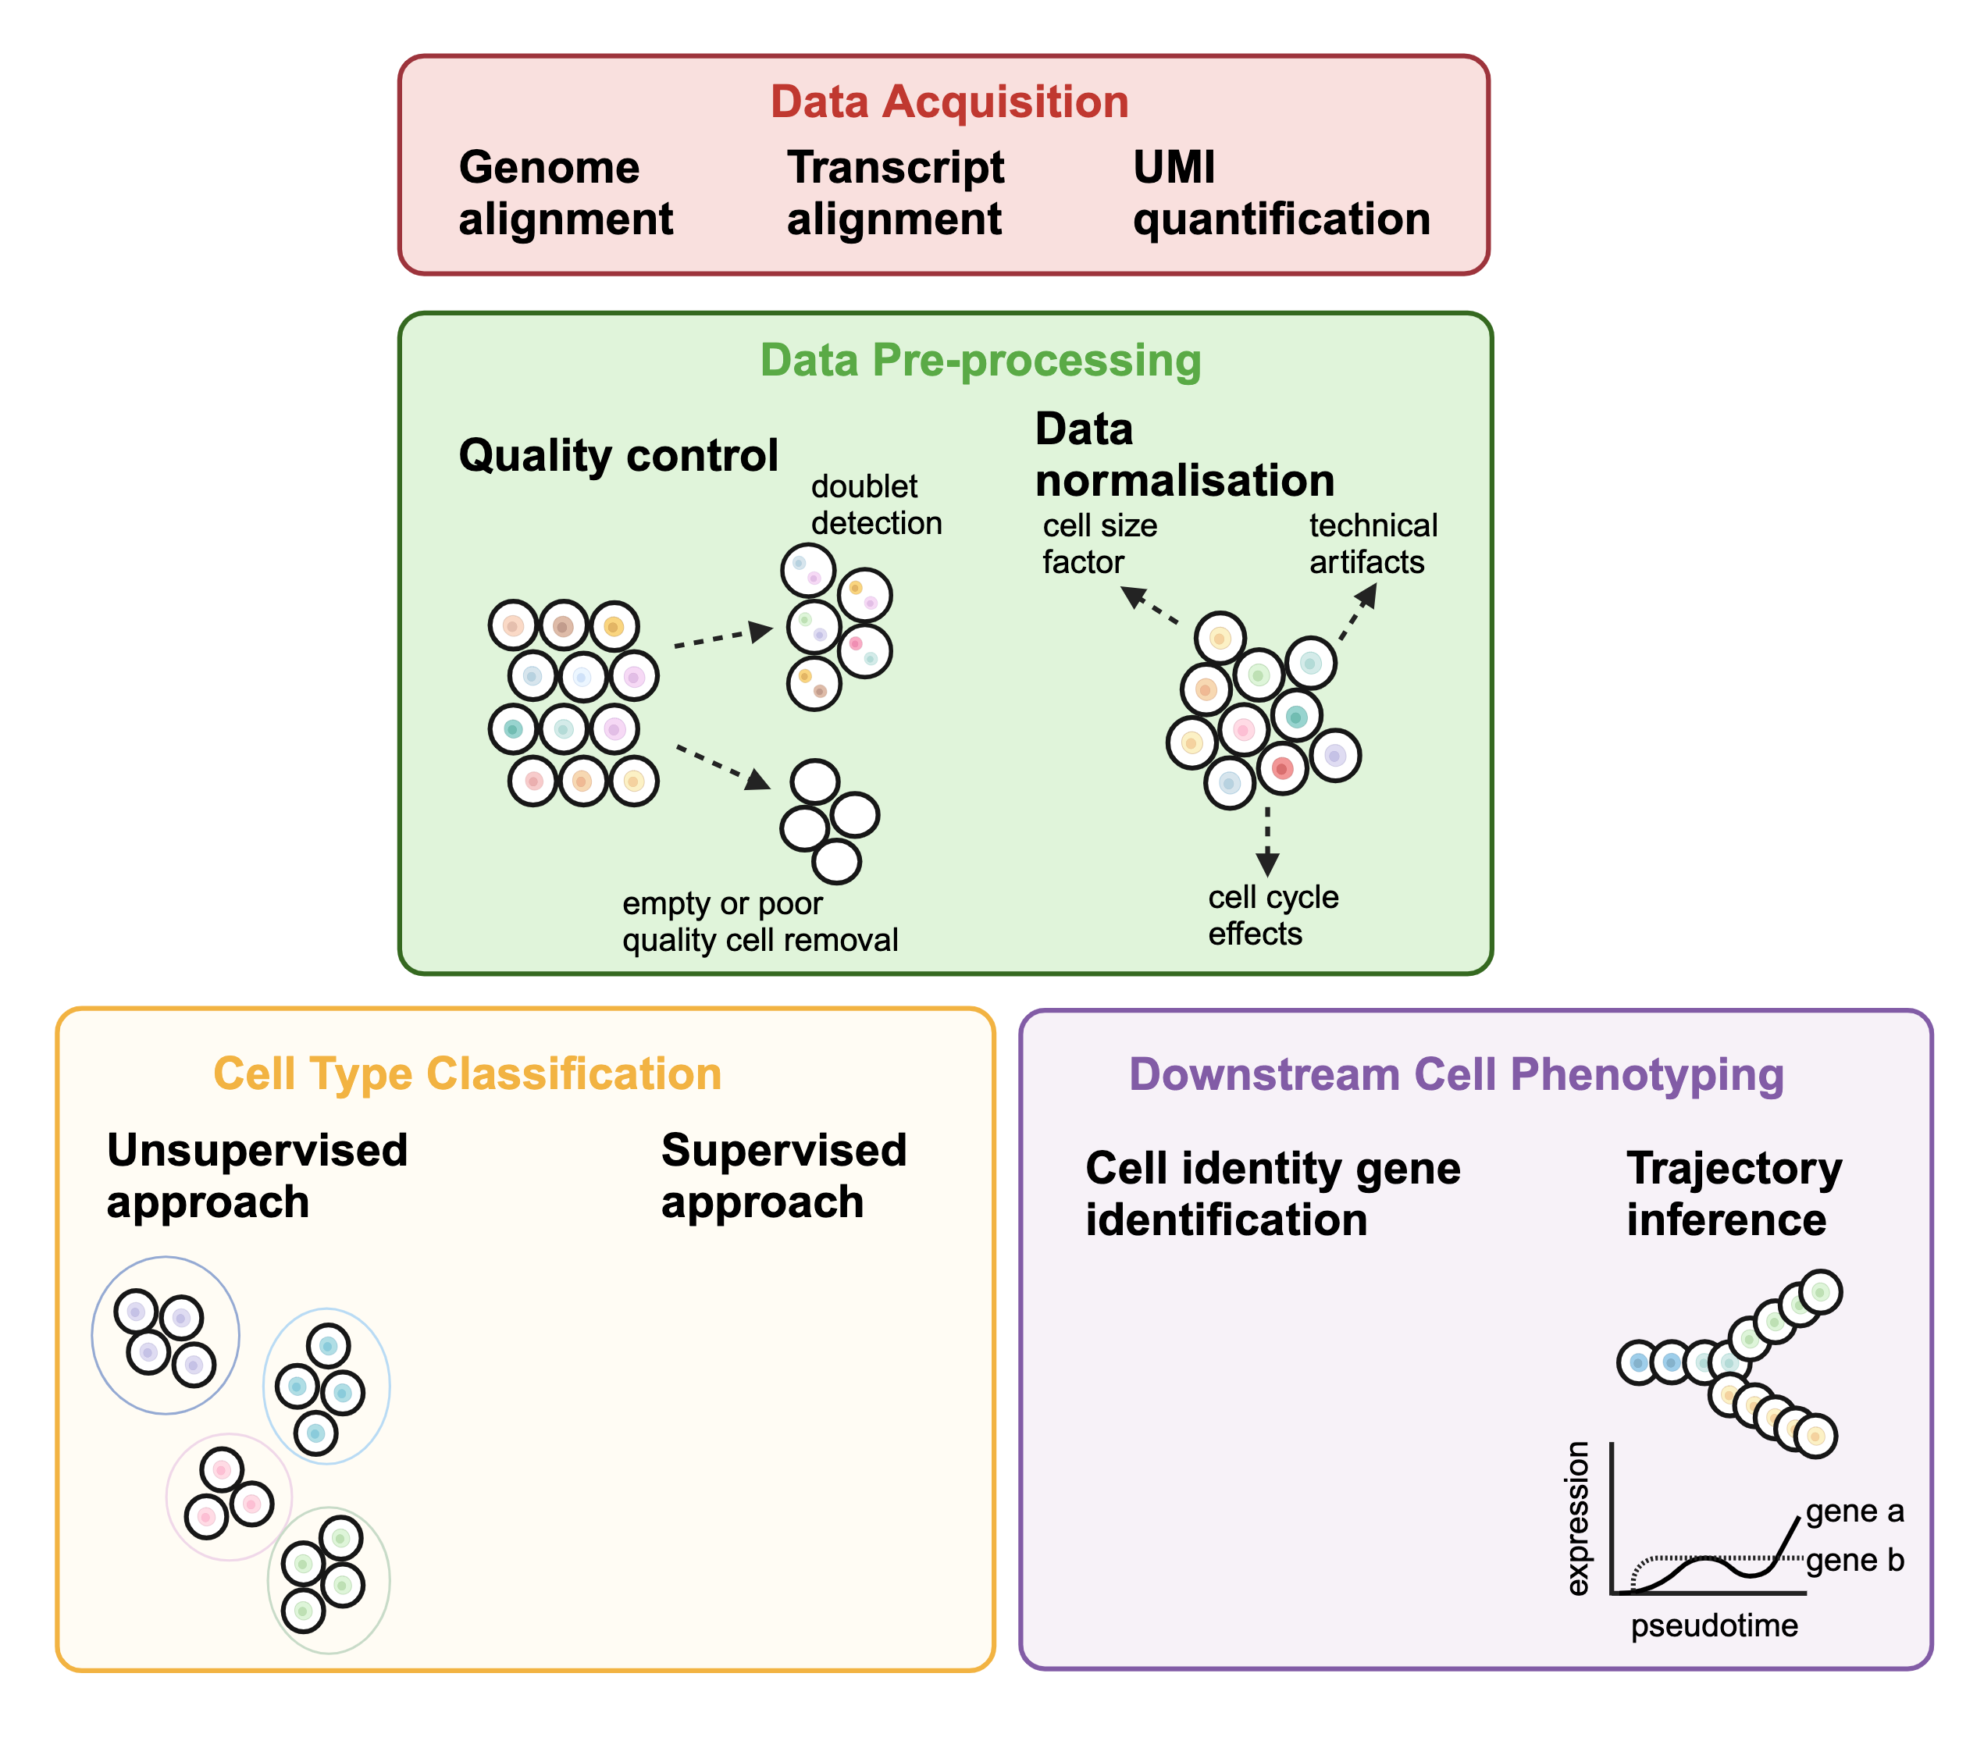
1. Data acquisition
Software
CellRanger for 10X Genomics data
STAR for alignment plus custom scripts (or STAR-solo)
Considerations
Single or mix of species?
Does it include ERCC spike-ins?
Do you need to build a custom reference for specific gene species?
Barcode and/or UMI sequencing errors – CellRanger takes care of this automatically
Align to exon, or exon and intron?
Input
BCL or fastq file from the sequencer
Output
Gene/cell counts matrix
Notes:
Each read typically comes with two tags – barcodes for the cell, UMI (Unique Molecular identifier)
A UMI (6-12 nc long) tags a unique transcript from the cell, improve the accuracy of RNA quantification by differentiating between technical duplicates (arising from PCR amplification) so then we can correct for PCR duplication so that our gene expression levels reflect the original transcript abundances
CellRanger – not open source software, wrapper for STAR

Slide 16
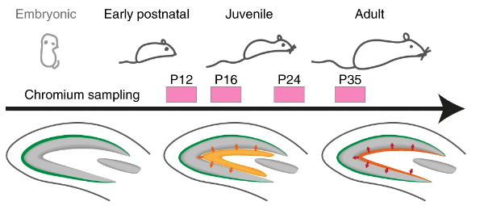
Dataset
From Hochgerner et al. (2018)
scRNA-seq (10X Chromium) of the mouse dentate gyrus from perinatal, juvenile and adult development
E16.5 – P132
24 unique cell types
Original data accessed from GSE104323
Raw count matrix contains 24,185 cells and 27,932 genes
Notes:
skip alignment
but it's easy to run yourself
usually run by bioinformatics facility
before, schematic of RNA to cellranger > counts matrix

Slide 17
Data pre-processing (Quality Control)
Software
Seurat
Scater
DropletUtils (removal of empty droplets)
miQC (model mtDNA counts)
Custom thresholding

Slide 18
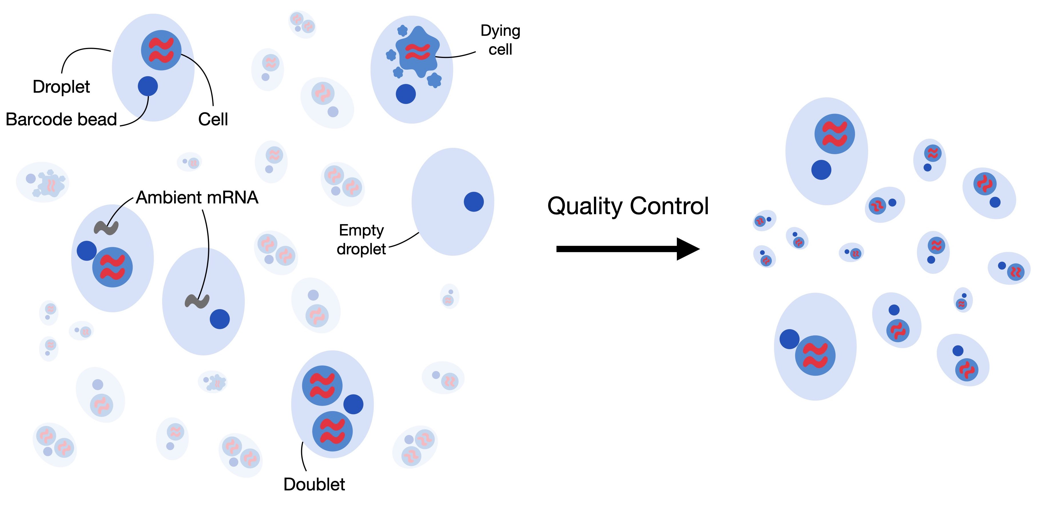
Data pre-processing (Quality Control)
Software
Seurat
Scater
DropletUtils (removal of empty droplets)
miQC (model mtDNA counts)
Custom thresholding
Considerations
Removal of doublets (Can estimate expected rate by doing species mixture experiment)
Notes:
A doublet is when 2 cells are encapsulated in a single droplet, leading to the attribution of double the amount of reads to a single cell
For the 10X platform, the reported doublet rate is 9% per 10,000 cells
underloading machine, to minimize doublet rate

Slide 19
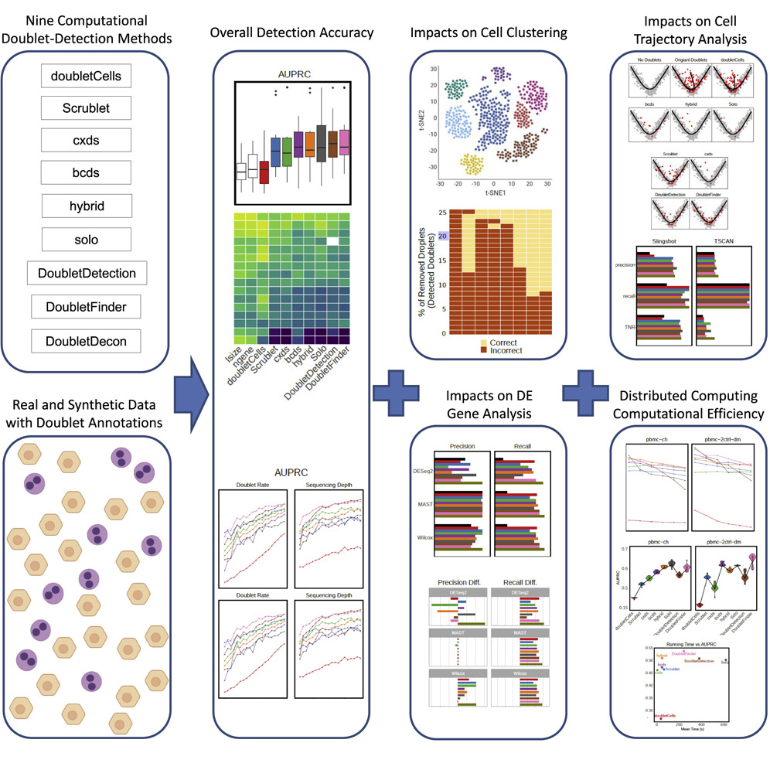
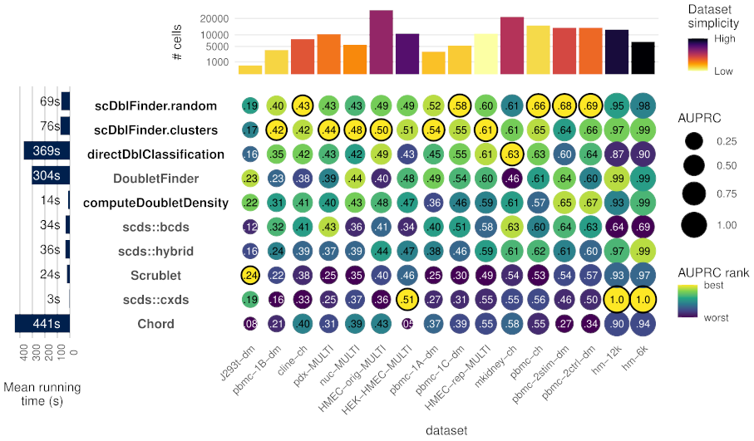
Benchmarking of doublet detection methods
Xi, N. & Li, J. Cell Systems (2020)

Slide 20
Data pre-processing (Quality Control)
Software
Seurat
Scater
DropletUtils (removal of empty droplets)
miQC (model mtDNA counts)
Custom thresholding
Considerations
Removal of doublets (Can estimate expected rate by doing species mixture experiment)
Removal of ambient mRNA contamination
Notes:
10x single cell assays typically capture some freely floating transcripts during the droplet-based capture process, resulting in a low level of background RNA counts referred to as ambient RNA
This can be a problem as it contaminates the endogenous mRNA profiles, and there’s typically an error in the read report where a large amounts of reads can’t be assigned to cell-associated barcodes
soupX

Slide 21
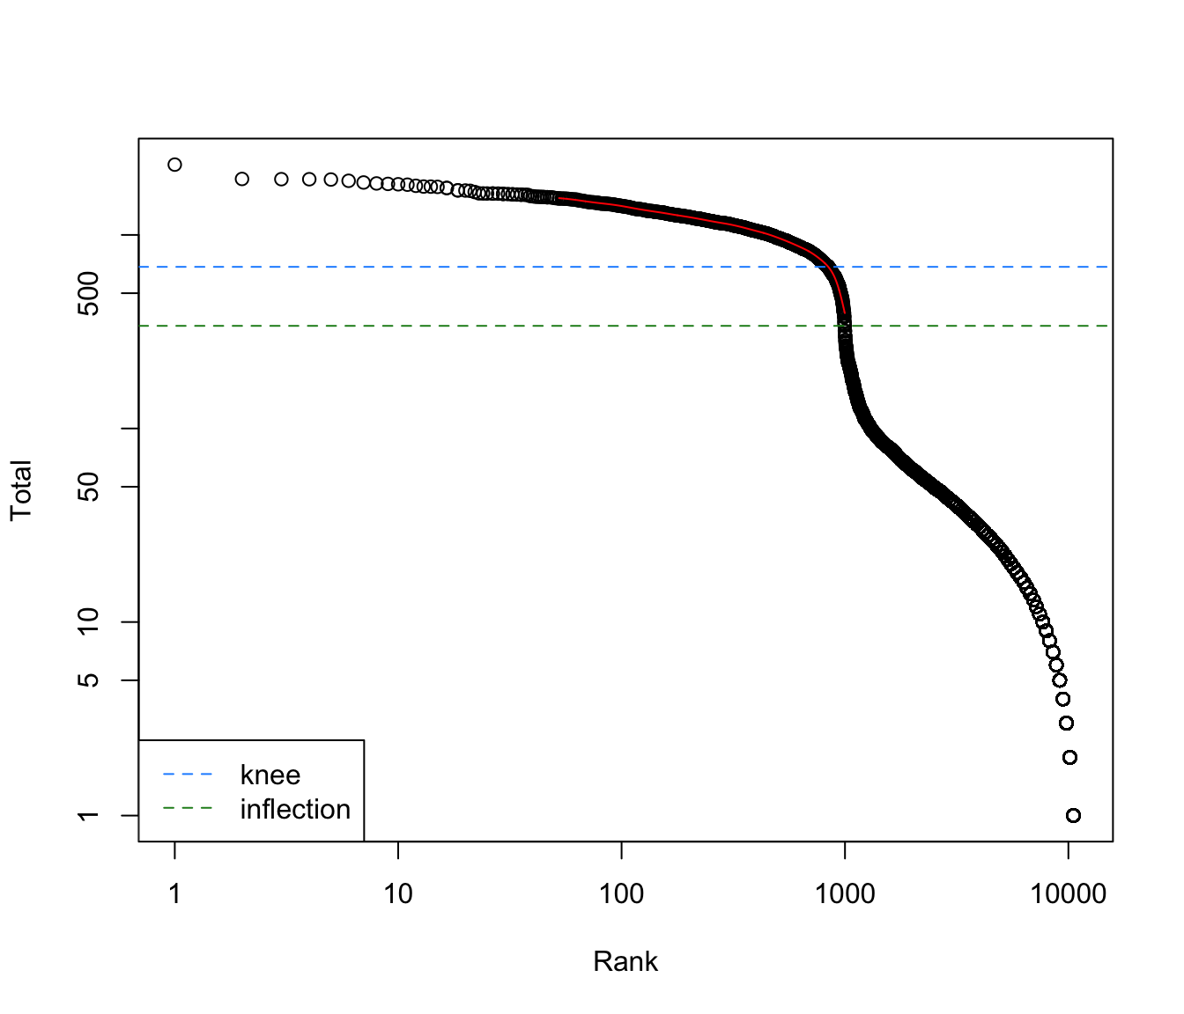
Data pre-processing (Quality Control)
Software
Seurat
Scater
DropletUtils (removal of empty droplets)
miQC (model mtDNA counts)
Custom thresholding
Considerations
Removal of doublets (Can estimate expected rate by doing species mixture experiment)
Removal of ambient mRNA contamination
Filter out droplets with no cells
Notes:
log-total count against the log-rank of each barcode, where the highest ranked barcodes have the lowest total UMI counts
It also shows the inflection and knee points on the curve, corresponding to the division of the total count distribution, predicting the difference between empty droplets and cell-containing droplets.
The knee point of a curve refers to the location where the curve starts to bend or change direction more sharply
Inflection is where the slope of the curve changes. So based on the inflection, those on the upper end are called as real cells and the bottom half are the empty droplets

Slide 22
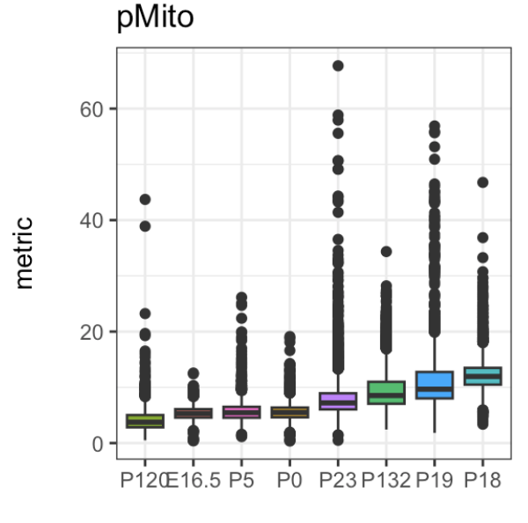
Data pre-processing (Quality Control)
Software
Seurat
Scater
DropletUtils (removal of empty droplets)
miQC (model mtDNA counts)
Custom thresholding
Considerations
Removal of doublets (Can estimate expected rate by doing species mixture experiment)
Removal of ambient mRNA contamination
Filter out droplets with no cells
Filter out dead cells (indicated by high mitochondrial gene counts or high spike-in counts)
Notes:
before and after filtering

Slide 23
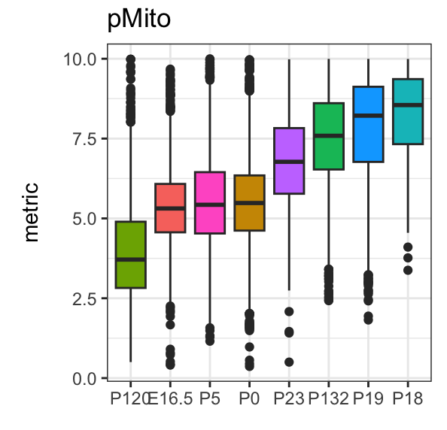
Data pre-processing (Quality Control)
Software
Seurat
Scater
DropletUtils (removal of empty droplets)
miQC (model mtDNA counts)
Custom thresholding
Considerations
Removal of doublets (Can estimate expected rate by doing species mixture experiment)
Removal of ambient mRNA contamination
Filter out droplets with no cells
Filter out dead cells (indicated by high mitochondrial gene counts or high spike-in counts)
Notes:
before and after filtering

Slide 24
Data normalisation
Software
Scran (Lun et al. Genome Biology 2016)
Seurat (Hao et al., Nature Biotechnology, 2023)
Normalisation aims to address:
Library size differences between cells due to technical artifacts
Scaling count data to obtain correct relative gene expression abundances between cells
After normalisation, data matrices are typically log(x+1)‐transformed
log transformation mitigates (but does not remove) the mean–variance relationship in single‐cell data
reduces the skewness of the data to make it more normally distributed
Batch correction
Luecken et al. Molecular Systems Biology (2019)
Notes:
focus on library size normalisation (correction)
To make cells comparable to each other
Technical artifacts such as mRNA capture efficiency, different sequencing depth
after library size, convert to log - convert to nomal-like, because count data is not normal distribution

Slide 25
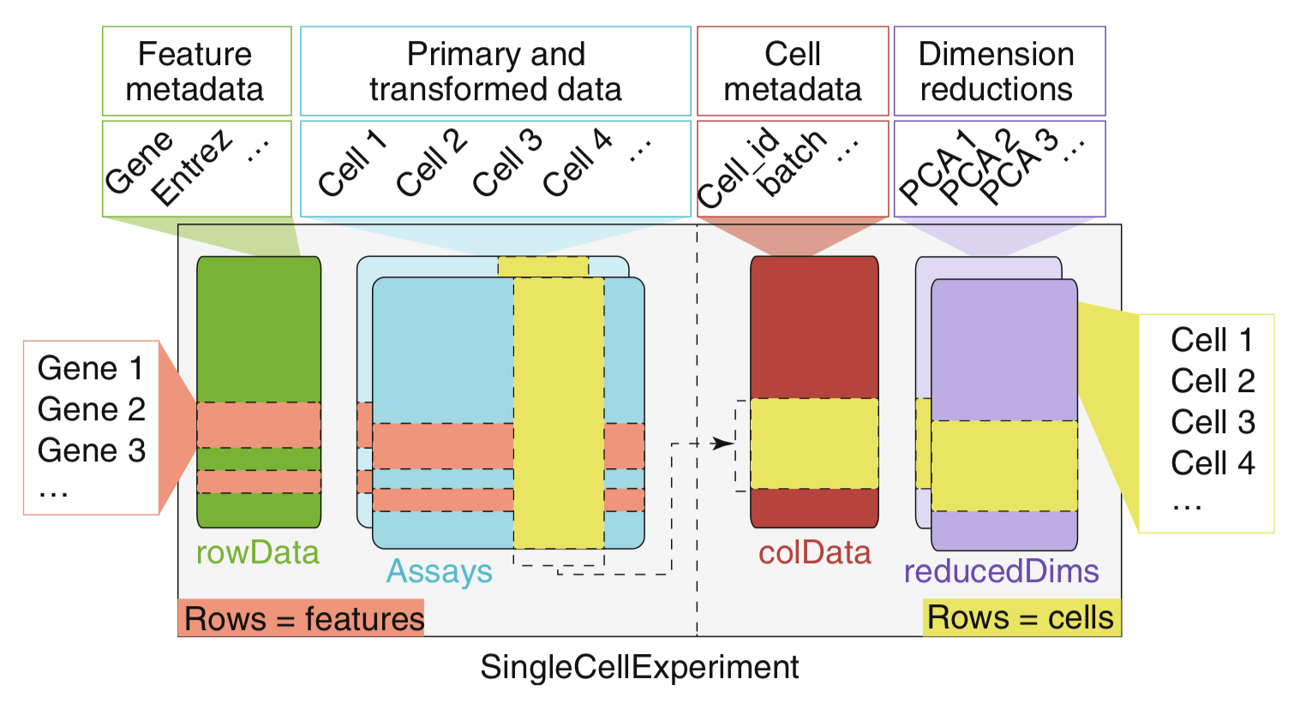
SingleCellExperiment Object
Amezquita et al. Nature Methods (2019)
Notes:
explain in more detail, include code for accessor functions and explain

Slide 26

[Coding break]

Slide 27
[15 minutes break] 10:35 – 10:50

Slide 28
Schedule
Setting up: 9:00 – 9:20 Google cloud set up and workshop introduction
Session 1: 9:20 – 10:35 Introduction to single-cell pre-processing
Session 2: 10:50 – 12:00 Basics of single-cell annotation
Session 3: 13:00 – 13:45 Introduction to trajectory analysis
Wrap up: 16:00 – 16:15 Conclusion and wrap up
Session 4: 13:45 – 14:30 Assessing appropriateness of trajectory
Session 5: 14:45 – 15:45 Characterisation of the trajectory
LUNCH: 12:00 – 13:00
BREAK: 10:35 – 10:50
BREAK: 14:30 – 14:45
Notes:
explain each bit one by one
Highlight Breaks and Lunch in BIG words

Slide 29
Session 2: 11:20 – 12:30
Basics of single-cell annotation

Slide 30
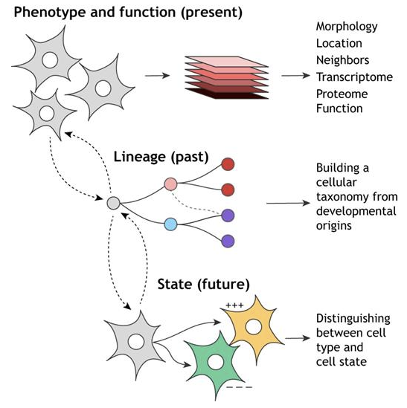
Definition of ‘cell type’
Cell annotation broadly refers to all procedures that aim to identify the identity and/or state of cells, as well as the relationship between cells.
Cell identity is a cumulation of the past, present and future of a cell with transcriptional activation of cell identity genes are the starting point to forming complex signalling networks that form the phenotype
Morris, S. Development (2019)
Notes:
Cell annotation broadly refers to all procedures that aim to identify the identity and/or state of cells, as well as the relationship between cells . Whilst cell identity has been extensively studied in the field of biomedical and basic science, it’s still by far an unresolved question and from yesterday’s talk, it is still quite subjective what a cell type is.
We can define cell identity as the culmination of the past, present and future of the cell with the activation and establishment of cell identity expression and signalling programs really being the starting point of when a cell begins to acquire its cellular identity.

Slide 31
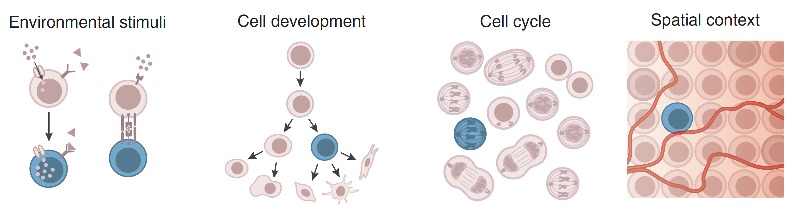
Cells experience multiple biological contexts that shape its identity
Wagner et al. Nat. Biotechnology (2016)
Notes:
The distinction between cell identity and cell state is often quite murky, but we often think of a cell’s identity coming in many forms or states depending on for example, the different external stimuli it is receiving, or it’s point along the cell development, or the stage in which the cell is in the cell cycle, or even a cell may exhibit different states depending on it’s spatial context.
All of these parameters contribute towards the diversity of cell phenotypes and today’s workshop is all about trying to begin quantifying and identifying these phenotypes.

Slide 32
Some questions on characterising cell types in the dataset
Questions | Analytical approach
What are the cell types present in the dataset? | Clustering or classification of cells
What are the marker genes that define my cell types? | Dimensionality reduction Feature selection to find cell identity genes
Does my dataset have temporal features or model continuous biological processes? | Trajectory analysis
What ligand-receptor interactions are happening between the cells? | Cell-cell communication (CiteFuse)
What do multiple modalities reveal about cell identity? | Integration of scRNA-seq and scATAC-seq

Slide 33
Some questions on characterising cell types in the dataset
Questions | Analytical approach
What are the cell types present in the dataset? | Clustering or classification of cells
What are the marker genes that define my cell types? | Dimensionality reduction Feature selection to find cell identity genes
Does my dataset have temporal features or model continuous biological processes? | Trajectory analysis

Slide 34

Workshop Overview (Day 1)

Slide 35
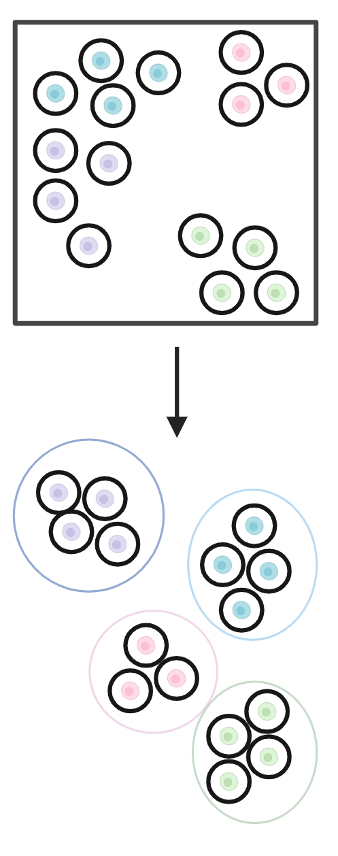
What is reference-free vs reference-based cell annotation?
Ref-free: No prior knowledge about identity of cell types
Grouping based
on gene expression
Notes:
Grouping based on transcriptomic similarity

Slide 36
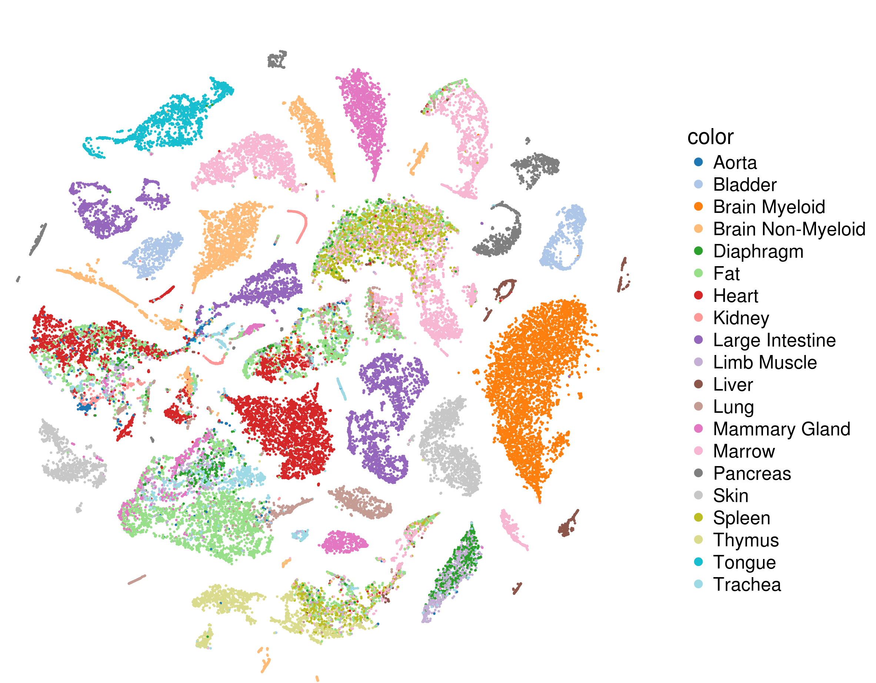
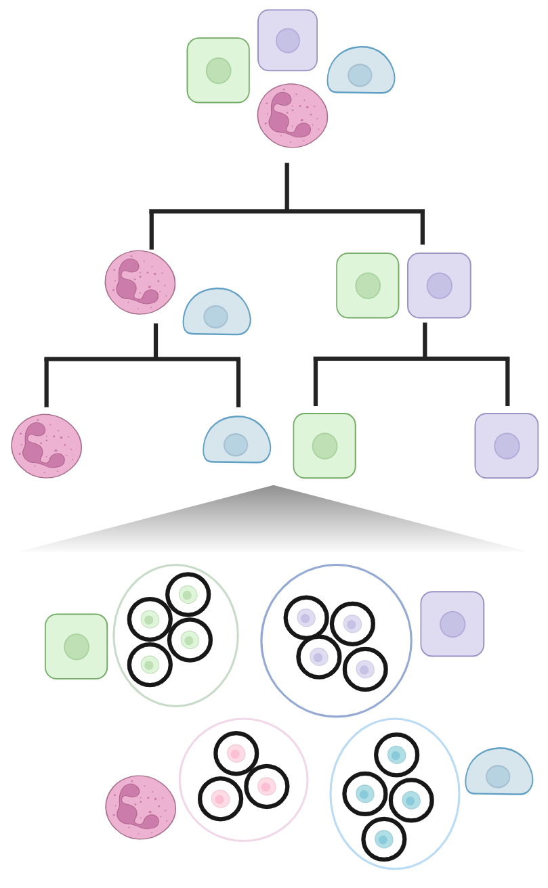
What is reference-free vs reference-based cell annotation?
Training a model
Using a reference
Ref-free: No prior knowledge about identity of cell types
Ref-based: learns from prior knowledge from a reference to classify cells
Grouping based
on gene expression
Using prior knowledge,
Learns relationship between cells
Apply model on query data to label cells
Notes:
Grouping based on transcriptomic similarity

Slide 37
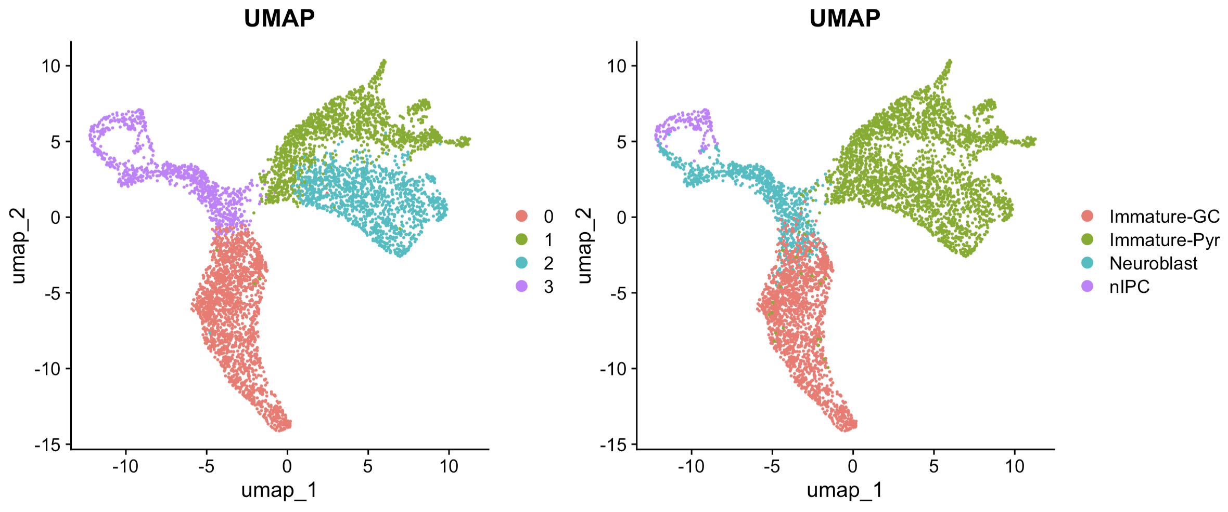
Approach 1: Reference-free
Most common approach to identifying cell types is first applying a clustering algorithm (eg. SC3, Louvain, leiden, SIMLR, CIDR…) then manual annotation of the resulting clustering using known marker genes
Limitations
Number of clusters rarely known in advance
Clusters may not necessarily represent a pure cell type
Annotation is highly dependent on prior knowledge of marker genes
Bias analysis towards better characterized cell types
Advantages
Novel cell type discovery
Used when there is no suitable single-cell reference available
Notes:
What is unsupervised vs supervised learning slide beforehand

Slide 38
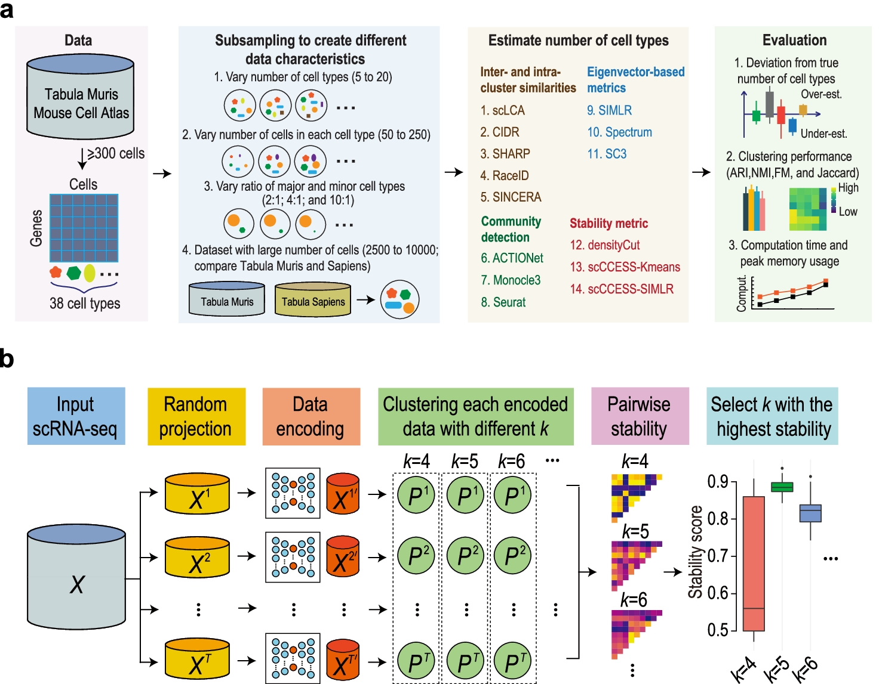
Benchmarking of clustering algorithms to estimate number of cell types
Yu et al. Genome Biology (2022)

Slide 39
Approach 2: Reference-based
Using existing pre-labelled single-cell datasets as a reference to train a classification model, then apply it on a new dataset to annotate each cell
Many methods out there: scmap, SingleR, ACTINN, CHETAH, scPred, scClassify…
Tabula Muris
Cell type prediction model

Slide 40
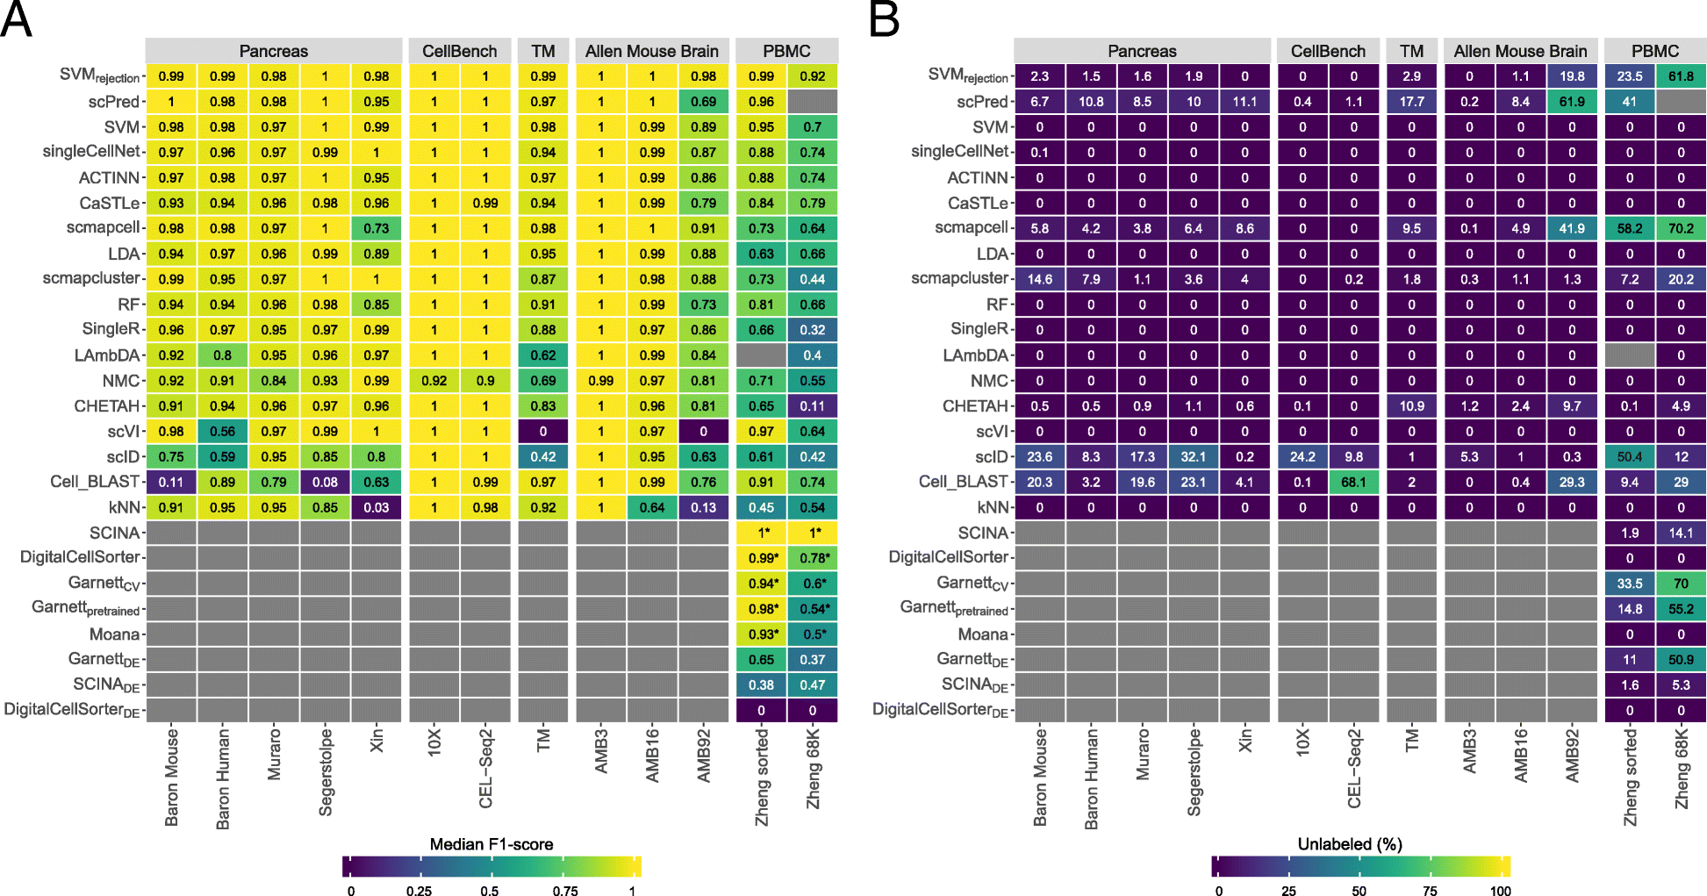
Benchmarking of classification algorithms
Abdelaal et al. Genome Biology (2019)
Notes:
scClassfiy published after, so not in it

Slide 41

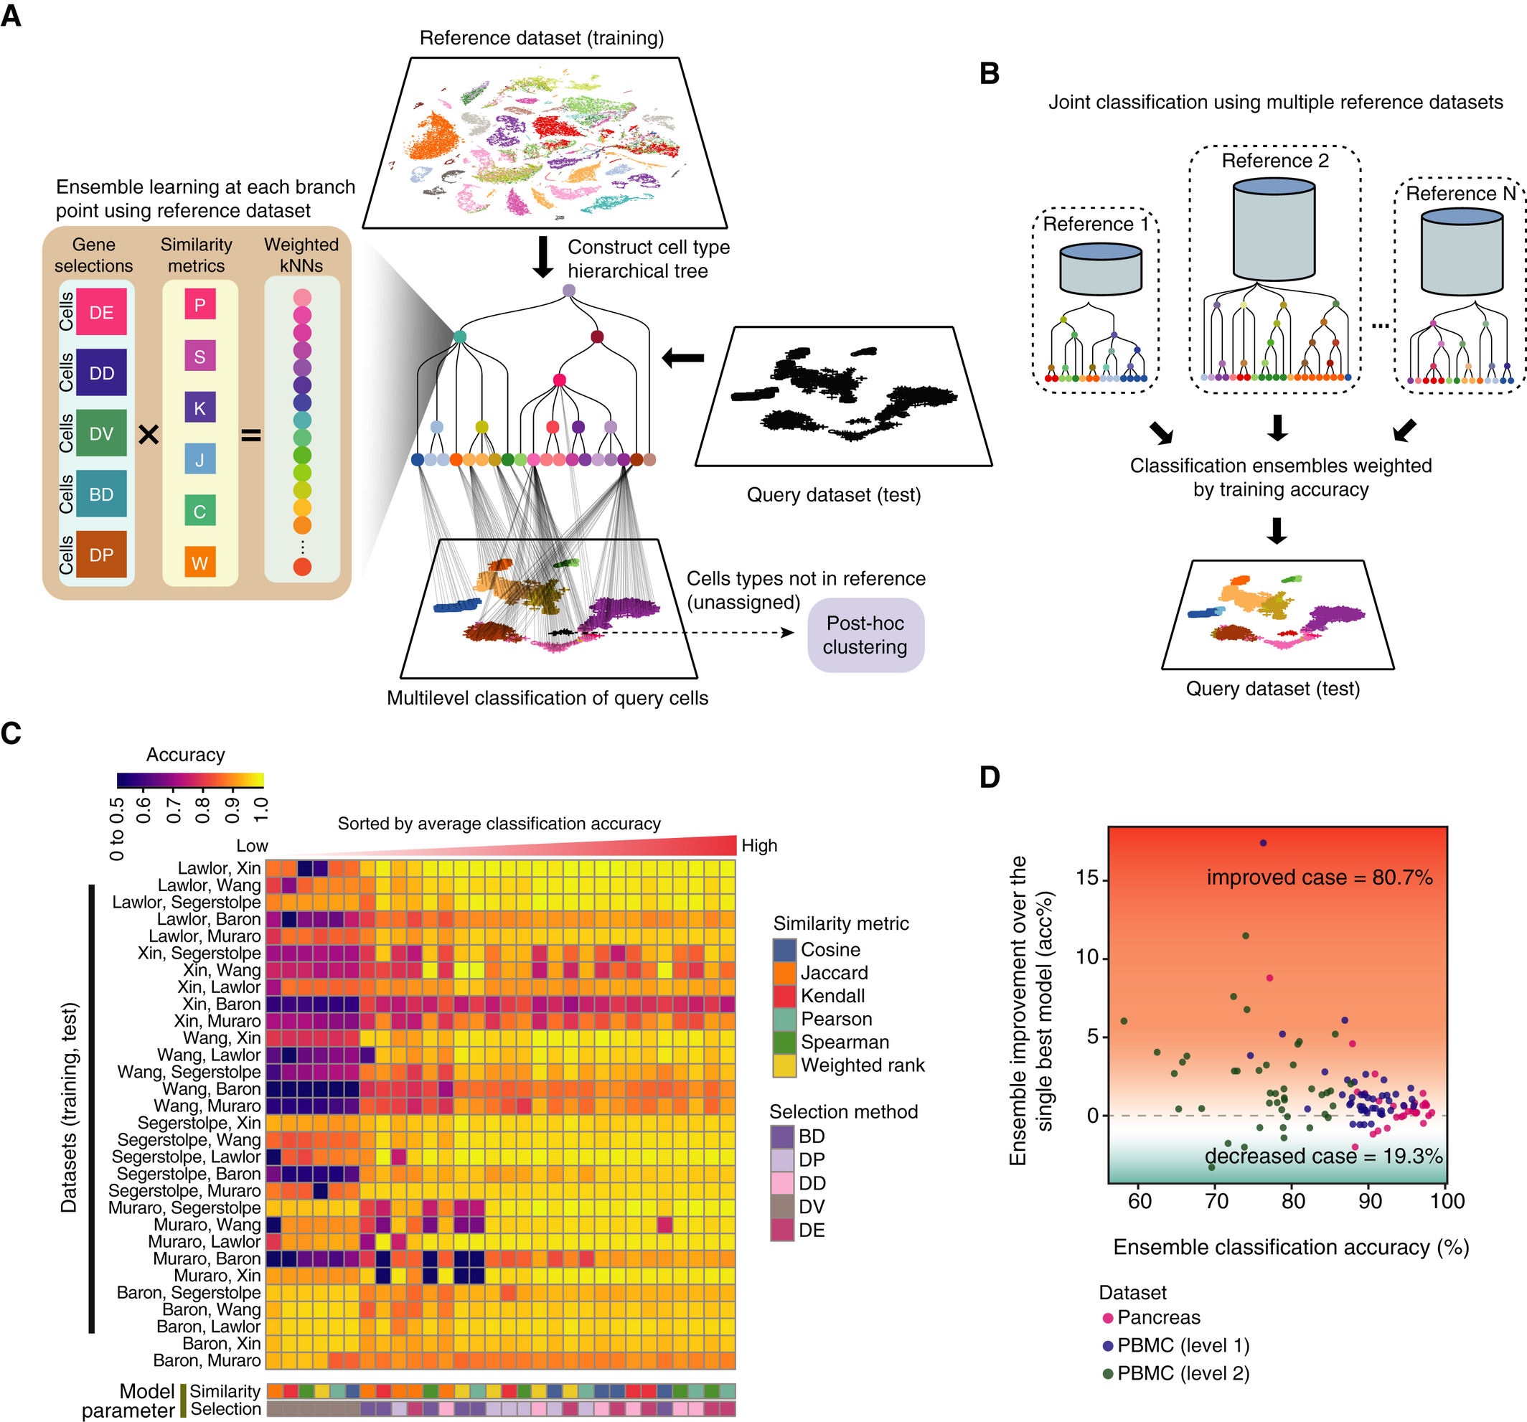
scClassify: Hierarchical classification
Lin et al. Mol. Syst. Biol. (2020)
Notes:
scClassify is a multiscale classification framework based on ensemble learning for cell type identification. scClassify first constructs a cell type tree from a reference dataset where cell types are organised in a hierarchy with increasingly fine‐tuned annotation. Next, scClassify uses a combination of gene selection methods and similarity metrics to develop an ensemble of weighted kNN classifiers that capture cell type characteristics at each non‐terminal branch node of the cell type hierarchy. These classifiers are then integrated to make predictions for every cell at each branch node of the cell type hierarchy.

Slide 42
T cells + NK cells + B cell
Step 1: Constructing cell type hierarchical tree
We use hierarchical ordered partitioning and collapsing hybrid (HOPACH) to generate the cell type hierarchical tree based on the reference dataset.
Monocyte
T cells + NK cells
DC
van der Laan, M. J. and Pollard, K. S. (2003), Journal of Statistical Planning and Inference.

Slide 43
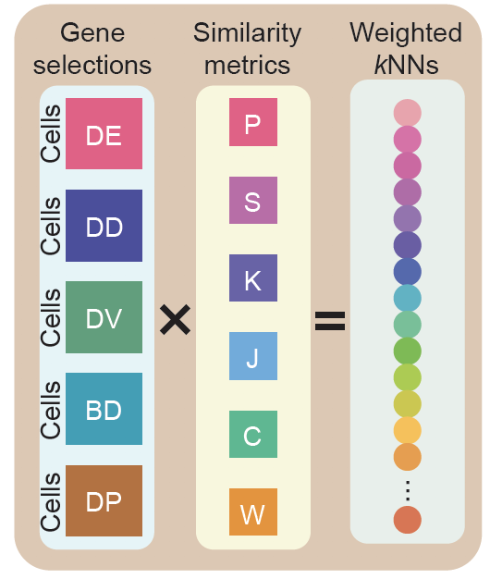
T cells + NK cells + B cell
Step 2: Feature selection at each branch point
Monocyte
T cells + NK cells
DC
Notes:
A weighted kNN is built for each branch point
kNN is a classifier where it will assign a class label to a query cell based on the weighted similarity or distance to the reference cell it has been trained on
More weight is given to neighbouring cells that are nearer, as defined by a similarity metric, to a query cell.

Slide 44
Ensemble learning
5 features
DE, DV, DD, Chi-squared test,
Bimodal index
6 similarity metrics
Pearson, Spearman, Kendall, Jaccard, Cosine, Weighted rank correlation,
30 base classifiers
Notes:
We also implement ensemble learning by combining five different feature selection methods and six similarity metrics to measure the nearest neighbour. Each base classifier will be weighted by the error trained in the reference dataset to build an ensemble classifier.

Slide 45
Ensemble learning
Diversity in performance across different parameter settings.
Different parameter combinations capture different cell type characteristics
Notes:
Here we show the classification accuracy using different distance metrics and feature selection methods. The labelling of the datasets are split by training and test respectively.

Slide 46
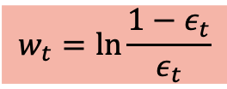
Weighted by
5 features
$$w_{t}=\ln{\frac{1−ε_{t}}{ε_{t}}}$$
DE, DV, DD, Chi-squared test,
Bimodal index
Where $ε_{t}$ indicates the error rate of the classifier in the reference dataset
Ensemble Classifier
6 similarity metrics
Pearson, Spearman, Kendall, Jaccard, Cosine, Weighted rank correlation,
30 base classifier
Notes:
Each base classifier will be weighted by the error trained in the reference dataset to build an ensemble classifier.

Slide 47
Step 3: Performing correlation-based weighted kNN for each level of the cell type hierarchical tree
In the testing step, the algorithm first predicts its first-level class. With this predicted cell type, from the second-level, the cells will only be tested on the model to distinguish its child nodes.

Slide 48
Cell ?
Step 3: Performing correlation-based weighted kNN for each level of the cell type hierarchical tree
In the testing step, the algorithm first predicts its first-level class. With this predicted cell type, from the second-level, the cells will only be tested on the model to distinguish its child nodes.

Slide 49

Cell ?
Step 3: Performing correlation-based weighted kNN for each level of the cell type hierarchical tree
In the testing step, the algorithm first predicts its first-level class. With this predicted cell type, from the second-level, the cells will only be tested on the model to distinguish its child nodes.
Cell T_B_NK

Slide 50
Step 3: Performing correlation-based weighted kNN for each level of the cell type hierarchical tree
In the testing step, the algorithm first predicts its first-level class. With this predicted cell type, from the second-level, the cells will only be tested on the model to distinguish its child nodes.
Cell T_B_NK
Cell T_NK

Slide 51
Step 3: Performing correlation-based weighted kNN for each level of the cell type hierarchical tree
In the testing step, the algorithm first predicts its first-level class. With this predicted cell type, from the second-level, the cells will only be tested on the model to distinguish its child nodes.
Cell T_NK
Cell
CD8 T

Slide 52
Step 3: Performing correlation-based weighted kNN for each level of the cell type hierarchical tree
In the testing step, the algorithm first predicts its first-level class. With this predicted cell type, from the second-level, the cells will only be tested on the model to distinguish its child nodes.
Cell
CD8 T
Cell Exhausted
CD8 T cell
Notes:
If the cells do not have high enough weighted scores to be assigned to the next level, it will be assigned to the nodes at the current level, as “intermediate” cells

Slide 53
Step 3: Performing correlation-based weighted kNN for each level of the cell type hierarchical tree
At every point, we can consider a cell not able to be “predicted”. These are term ”intermediate” or “unassigned”.
Intermediate
Notes:
If the cells do not have enough weighted scores to be assigned to the next level, it will be assigned to the nodes at the current level, as “intermediate” cells
And if the cells are not able to be assigned even on the top level, it will be classified as “unassigned”
First, the nearest neighbour cells must have correlations higher than a certain threshold.
Second, the weights of its assigned cell type must be larger than a certain threshold, whose default is set at 0.7.

Slide 54
unassigned
Step 3: Performing correlation-based weighted kNN for each level of the cell type hierarchical tree
At every point, we can consider a cell not able to be “predicted”. These are term ”intermediate” or “unassigned”.
Notes:
And if the cells are not able to be assigned even on the top level, it will be classified as “unassigned”

Slide 55
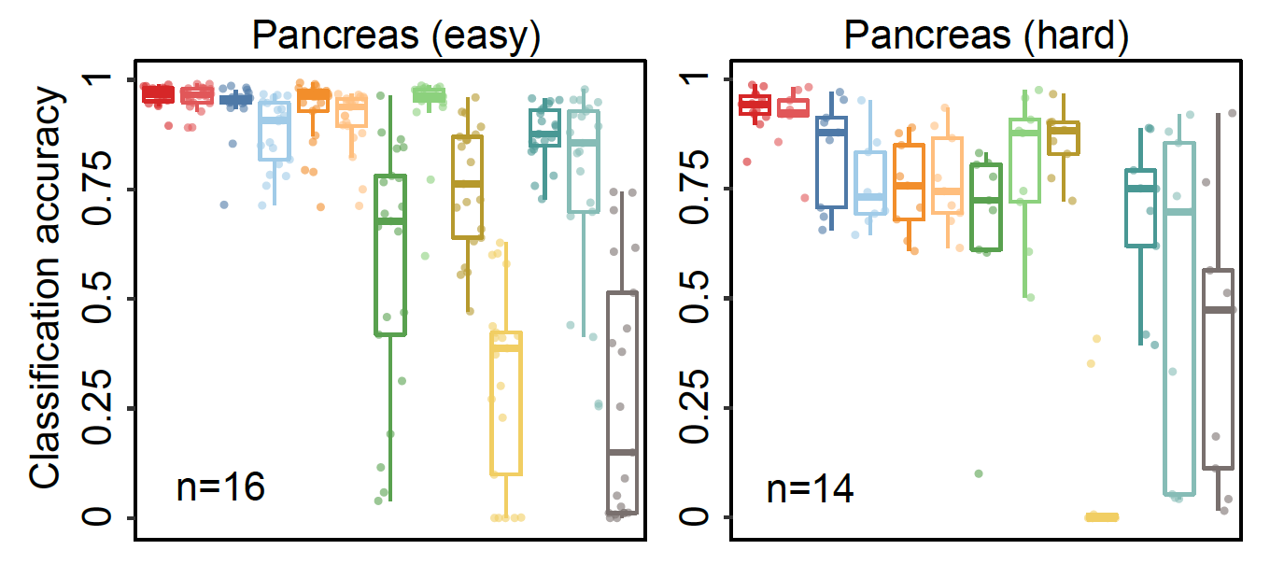
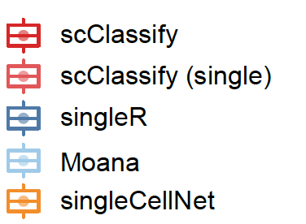
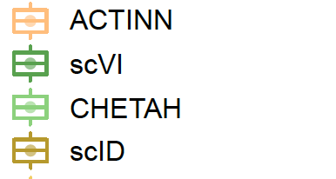
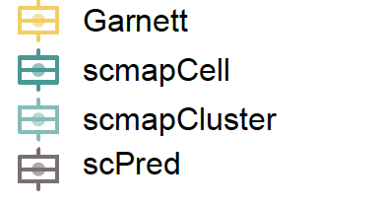
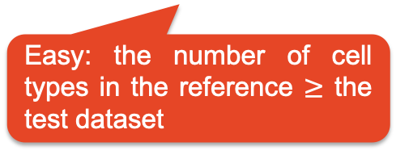
Evaluation of scClassify performance
Easy: the number of cell types in the reference $≥$ the test dataset
Notes:
Given the previous results, we will compare the ensemble classifier to benchmarking results.
Here are the benchmark results for Pancreas dataset collections.
Each point here indicates one pair of training and test combination. And the y-axis is the accuracy rate. We define the cases that the number of cell type in the training less than the test dataset as “Hard”, and only scClassify, especially the ensemble version of scClassify remains with a high accuracy rate.

Slide 56
Evaluation of scClassify performance
Hard: the number of cell types in the reference < the test dataset
Easy: the number of cell types in the reference $≥$ the test dataset
Notes:
Here are the benchmark results for Pancreas dataset collections.
Each point here indicates one pair of training and test combination. And the y-axis is the accuracy rate. We define the cases that the number of cell type in the training less than the test dataset as “Hard”, and only scClassify, especially the ensemble version of scClassify remain high accuracy rate.

Slide 57
Evaluation of scClassify performance
Hard: the number of cell types in the reference < the test dataset
scClassify is able to correctly unassign cells
Easy: the number of cell types in the reference $≥$ the test dataset
Notes:
Here are the benchmark results for Pancreas dataset collections.
Each point here indicates one pair of training and test combination. And the y-axis is the accuracy rate. We define the cases that the number of cell type in the training less than the test dataset as “Hard”, and only scClassify, especially the ensemble version of scClassify remain high accuracy rate.

Slide 58
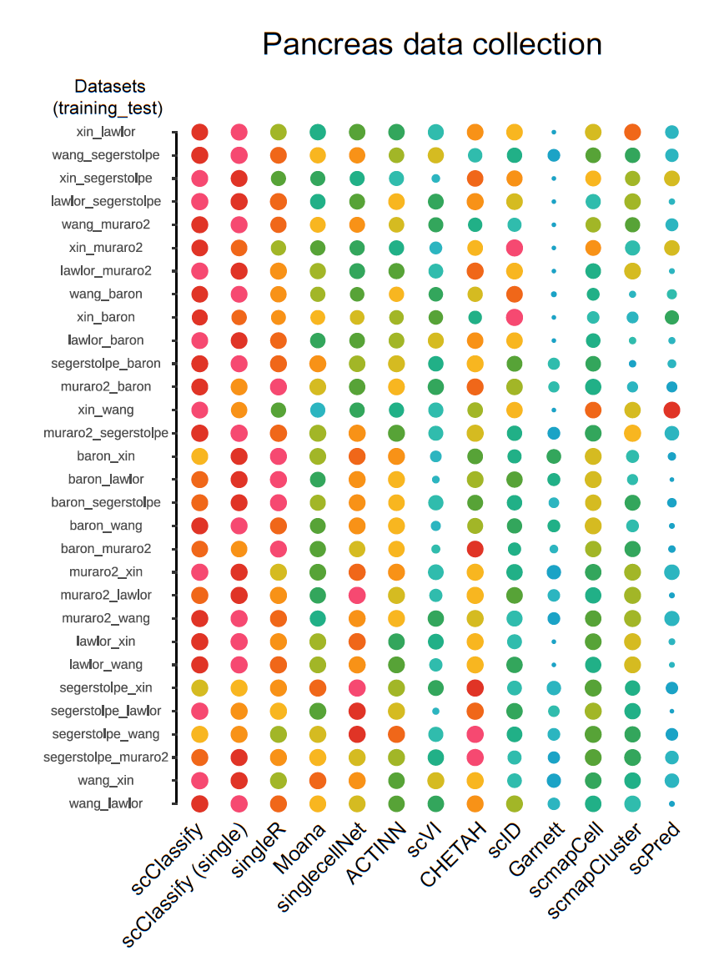
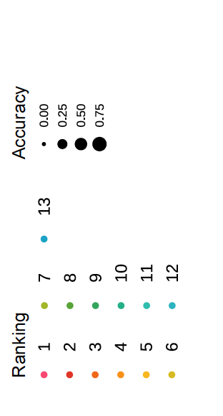
On average, scClassify achieves a higher accuracy than the other methods, with the difference being greater among hard cases than the easy ones.

Slide 59
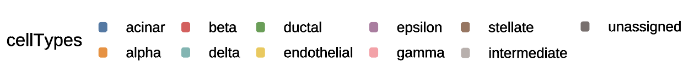
Post-hoc clustering for ‘unassigned’ cells
Reference data Xin et al. (4 cell types)
Query data Muraro et al.
beta
delta
alpha
beta
scClassify
delta
gamma
alpha
gamma
unassigned

Slide 60
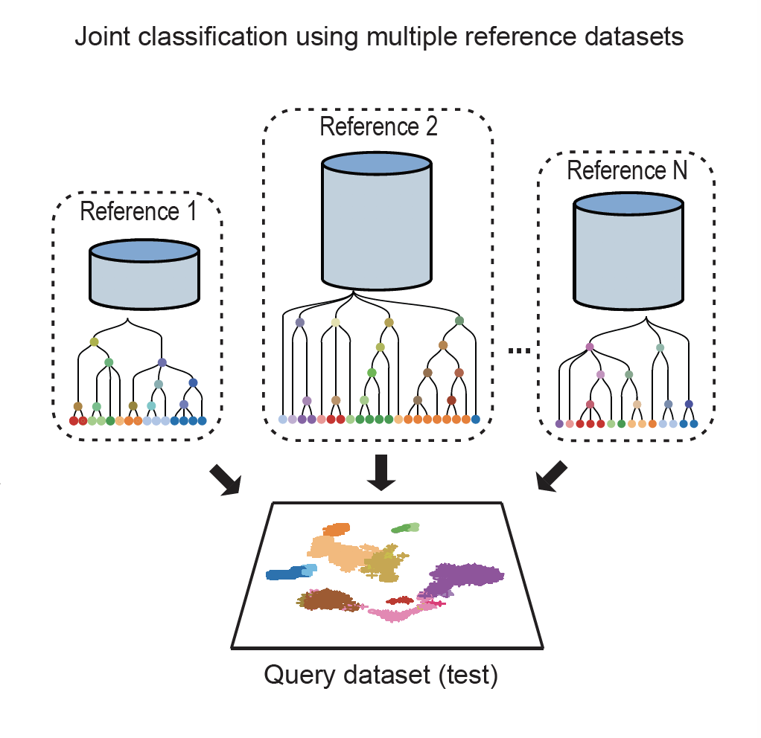
Joint classification with scClassify

Slide 61
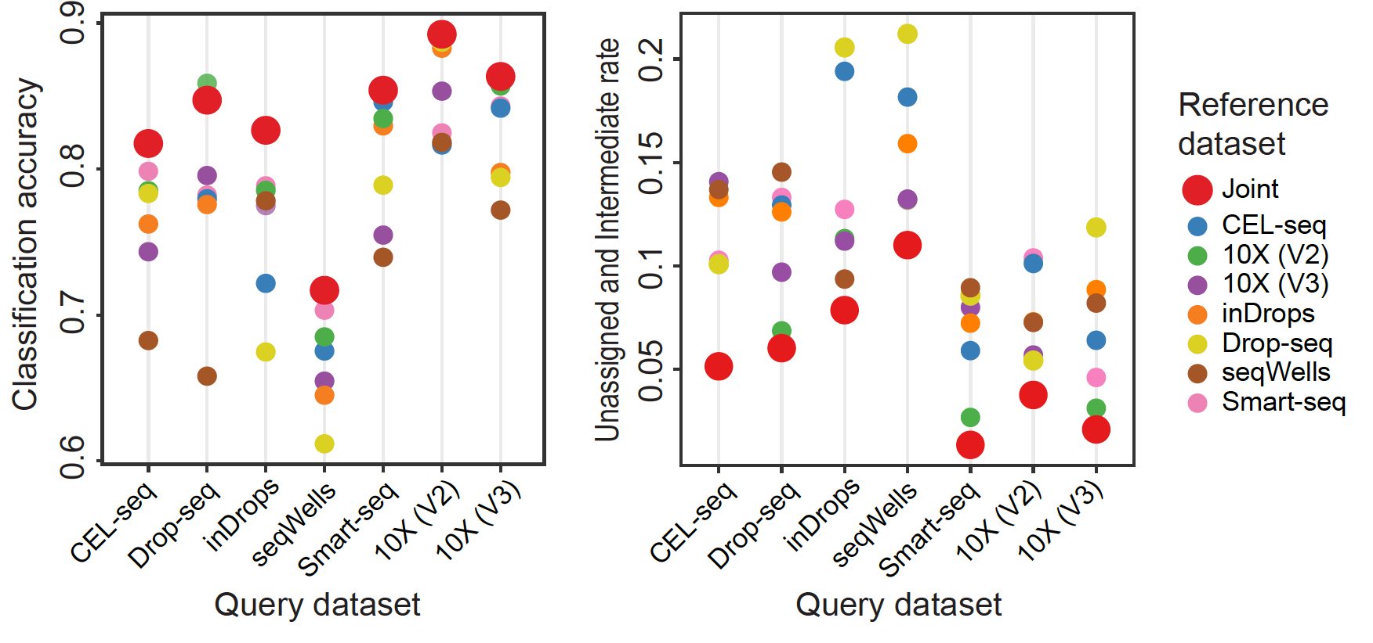
Evaluation of joint classification
Notes:
Classification accuracy of a collection of PBMC datasets from different technologies. The red dot is the joint classification of the multiple references and the other colours are the single models. We see that in both overall classification accuracy and rate of unassigned or intermediate cells are lower than other models using a single reference

Slide 62
[Coding break]

Slide 63
[Lunch break] 12:00 – 13:00

Slide 64
Schedule
Setting up: 9:00 – 9:20 Google cloud set up and workshop introduction
Session 1: 9:20 – 10:35 Introduction to single-cell pre-processing
Session 2: 10:50 – 12:00 Basics of single-cell annotation
Session 3: 13:00 – 13:45 Introduction to trajectory analysis
Wrap up: 16:00 – 16:15 Conclusion and wrap up
Session 4: 13:45 – 14:30 Assessing appropriateness of trajectory
Session 5: 14:45 – 15:45 Characterisation of the trajectory
LUNCH: 12:00 – 13:00
BREAK: 10:35 – 10:50
BREAK: 14:30 – 14:45
Notes:
explain each bit one by one
Highlight Breaks and Lunch in BIG words

Slide 65
Session 3: 13:30 – 14:15
Introduction to trajectory analysis

Slide 66
Workshop Overview (Day 1)

Slide 67
Dataset
From Hochgerner et al. (2018)
scRNA-seq (10X Chromium) of the mouse dentate gyrus from P0 and P5
4 unique cell types
Original data accessed from GSE104323

Slide 68
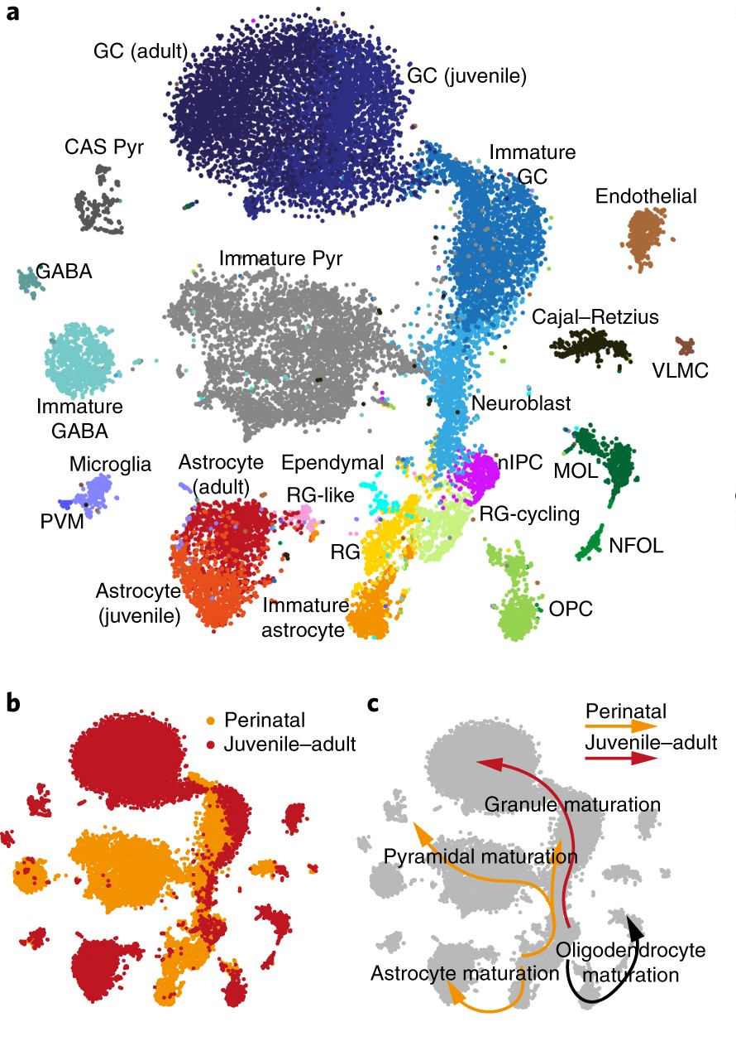
Using trajectory analysis to reconstruct temporal cellular progression
What is the developmental journey of a cell throughout time?
Purpose: to model the continuous process of cellular development eg. differentiation, cell state transitions

Slide 69
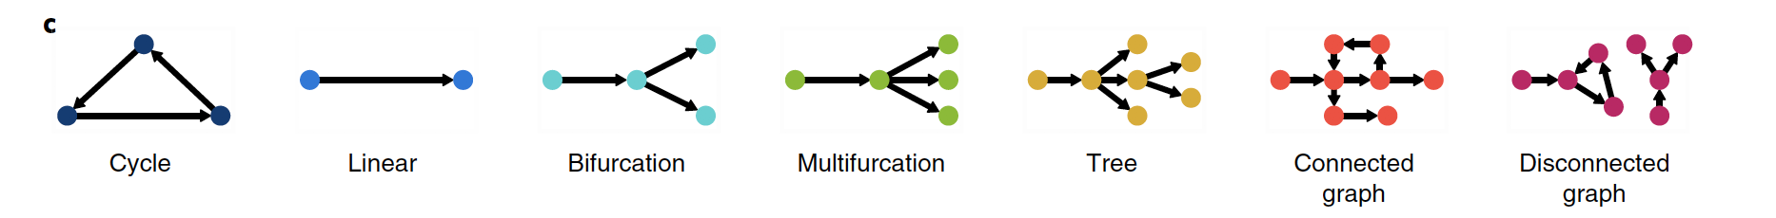
Different trajectories
Saelens et al. Nat. Biotech. (2019)
Notes:
And a myriad of inference methods are available and you can choose the one that suits the assumptions of your data the most.
Given that we see clear branching of cells and complex structure in our data, we can safely rule out a linear trajectory for example.

Slide 70
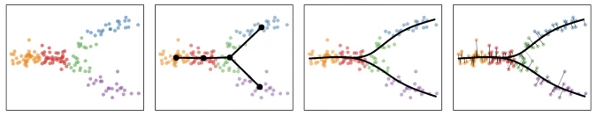
Building a trajectory – three key components
Step 1:
Feature selection
DE
PCA
Cepo
Step 2:
Dimensionality reduction
TSNE
UMAP
Step 3: Creating a lineage structure with pseudo time inference
Slingshot
Monocle3 and more

Slide 71
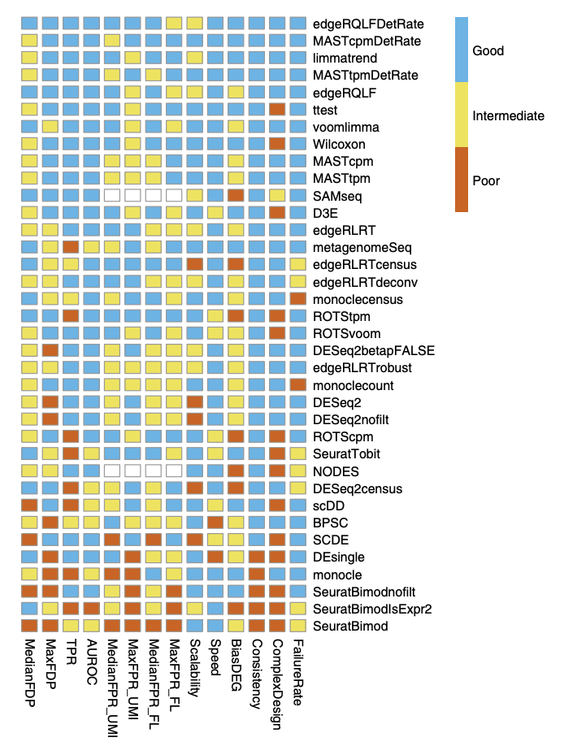

Step 1: Feature selection
Soneson and Robinson,
Nature Methods (2018)

Slide 72
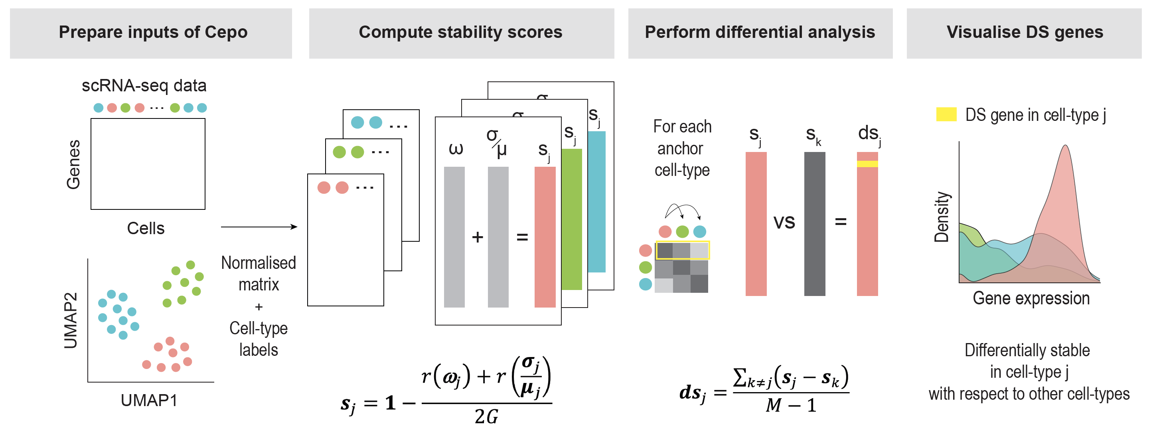
Differential stability: A new metric to define cell identity
Cell identity genes that are important for the maintenance and core functions of a cell should be stably expressed
Kim et al. Nat. Compsci. (2021)
Notes:
The motivation of Cepo is based on the intuition that a typical cell identity gene should be stably expressed in most cells of the cell type of interest relative to other cell types, and therefore should fulfill both high coverage and low variability in the cell type of interest relative to other cell types.
using predefined cell-type labels, we compute cell-type-specific statistics to prioritise genes that are differentially stable against other cell types in all cell-type pair comparisons
Cepo calculates for each gene and cell type the stability scores using two stability measures: the proportion of zeros and variability, for which we found that the coefficient of variation (standard deviation/mean) variability relative to gene expression
Cepo then computes the DS statistics by taking the average of the difference in the stability scores between the cell type of interest against all other individual cell types, maximising the specificity of both measures

Slide 73


Step 2: Dimensionality reduction
Notes:
Perform dimensionality reduction.

Slide 74


Step 3: Creating a lineage structure using pseudotime inference
The effectiveness of current trajectory inference tools for transcriptomics data has been extensively in Saelens et al. 2019
https://github.com/dynverse/dynbenchmark/
Notes:
And finally, we construct a lineage structure and calculate the pseudotime in the low dimensional space.

Slide 75

SeuratObject
Access gene expression matrices: GetAssayData()
GetAssayData(seuratObject, assay=“RNA”, layer=“counts”)
Access cell metadata:
seuratObject@metadata
seuratObject$column_name
Access dimension reduction embeddings:
Embeddings(seuratObject, “umap”)
Lior Pachter’s twitter

Slide 76
[Coding break]

Slide 77
Schedule
Setting up: 9:00 – 9:20 Google cloud set up and workshop introduction
Session 1: 9:20 – 10:35 Introduction to single-cell pre-processing
Session 2: 10:50 – 12:00 Basics of single-cell annotation
Session 3: 13:00 – 13:45 Introduction to trajectory analysis
Wrap up: 16:00 – 16:15 Conclusion and wrap up
Session 4: 13:45 – 14:30 Assessing appropriateness of trajectory
Session 5: 14:45 – 15:45 Characterisation of the trajectory
LUNCH: 12:00 – 13:00
BREAK: 10:35 – 10:50
BREAK: 14:30 – 14:45
Notes:
explain each bit one by one
Highlight Breaks and Lunch in BIG words

Slide 78
Session 4: 14:15 – 15:00
Assessing appropriateness of trajectory

Slide 79
Is my trajectory appropriate or sensible?
In this section, we will look at the critical thinking questions that a researcher will ask about the trajectory.
There are several parameters that may affect the final inferred pseudotime, such as
the selection of features,
the choice of dimensionality reduction technique
the method of lineage inference etc.
Note: finding the most optimal parameters may be data specific and requires close inspection of the final pseudotime against expected and known biological knowledge.
Notes:
In this section, we illustrate we can begin this tuning process by running the above analysis using a different dimension reduction technique and visualize the results.

Slide 80
After you build your trajectory:
QC questions with domain context
Are there distinguishing features between trajectories?
Do these orderings make sense given the cluster labels? Why?

Slide 81
After you build your trajectory:
Bioinformatics questions
How well do the pseudotime orderings correlate from different trajectory methods?
QC questions with domain context
Are there distinguishing features between trajectories?
Do these orderings make sense given the cluster labels? Why?

Slide 82


Comparing slingshot and monocle3
Slingshot
Monocle3

Slide 83

Scatter plot of the two trajectory inference methods
By generating a scatter plot of the correlation between the inferred pseudotime values from slingshot and monocle3, we can see that the trajectories from both methods are highly correlated with each other (0.97).
We illustrate the results for Lineage 1
What do they look like for the other lineage?

Slide 84
After you build your trajectory:
Bioinformatics questions
How well do the pseudotime orderings correlate from different trajectory methods?
How does the choice of dimensionality reduction affect the trajectory inference?
Would performing dimensionality reduction with a different set/number of selected features impact the trajectory results?
Can we use order cells in monocle3 if we do not know what the root cell type is?
QC questions with domain context
Are there distinguishing features between trajectories?
Do these orderings make sense given the cluster labels? Why?

Slide 85
[Coding break]

Slide 86
[15 minutes break] 14:30 – 14:45

Slide 87
Schedule
Setting up: 9:00 – 9:20 Google cloud set up and workshop introduction
Session 1: 9:20 – 10:35 Introduction to single-cell pre-processing
Session 2: 10:50 – 12:00 Basics of single-cell annotation
Session 3: 13:00 – 13:45 Introduction to trajectory analysis
Wrap up: 16:00 – 16:15 Conclusion and wrap up
Session 4: 13:45 – 14:30 Assessing appropriateness of trajectory
Session 5: 14:45 – 15:45 Characterisation of the trajectory
LUNCH: 12:00 – 13:00
BREAK: 10:35 – 10:50
BREAK: 14:30 – 14:45
Notes:
explain each bit one by one
Highlight Breaks and Lunch in BIG words

Slide 88
Session 5: 15:15 – 16:15
Characterisation of the trajectory

Slide 89



Within a lineage, which genes are differentially expressed across a pseudotime?
Models gene expression as it changes over pseudotime using a Negative Binomial GAM (NB-GAM)
Use the ‘Association Test’ to find genes whose expression changes associated with pseudotime
Gene A
TradeSeq, Van den Berge et al. (2020)
Notes:
Since the pattern is likely not linear, a GAM captures the nonlinear patterns

Slide 90


Which genes exhibit different patterns of gene expression across the pseudotime between lineages?
Using the ‘Pattern Test’
Across different windows of pseudotime it compare gene expression levels between lineages
We can identify both differences in patterns of expression as well as genes with similar patterns but different mean expression across the pseudotime range
TradeSeq, Van den Berge et al. (2020)

Slide 91

Can we group the genes in terms of their gene expression patterns across the pseudotime?
Clustering of genes according to their gene expression pattern across pseudotime
We can also characterise a given a gene set (clusters) by examining enrichment of gene pathways
TradeSeq, Van den Berge et al. (2020)

Slide 92
[Coding break]

Slide 93


Which gene-pair correlations change across pseudotime?
scHOT
Aims to capture deterministic genes that display subtle changes in patterns of variation and co-expression
Examine changes in correlation of gene pairs across developmental time
Ghazanfar et al. Nature Methods (2020)

Slide 94




Explaining differential correlation
Consider the expression of gene x and gene y
Now consider the expression of gene x and gene z
Local correlation
Local correlation
Constant correlation
Differential correlation

Slide 95


By examining a sequence of local weights we can infer changes in local higher order interactions
Differentiation
trajectory
Correlation
Notes:
However, when we consider single cells – especially from developmental systems - rarely are they actually split into discrete groups, but tend to be caught along a continuum. This represents a challenge when we want to perform any sort of differential analysis taking higher order interactions into account. i.e. to calculate a variance, I need to take multiple samples, same with correlation. We could artificially split our data into discrete groups, but this could introduce arbitrary biases and obscure important characteristics in our analyses.

Slide 96

Variability
Differentiation
trajectory
Independent relationship between correlation of gene pairs and variability of gene expression
Notes:
However, when we consider single cells – especially from developmental systems - rarely are they actually split into discrete groups, but tend to be caught along a continuum. This represents a challenge when we want to perform any sort of differential analysis taking higher order interactions into account. i.e. to calculate a variance, I need to take multiple samples, same with correlation. We could artificially split our data into discrete groups, but this could introduce arbitrary biases and obscure important characteristics in our analyses.

Slide 97
Schedule
Setting up: 9:00 – 9:20 Google cloud set up and workshop introduction
Session 1: 9:20 – 10:35 Introduction to single-cell pre-processing
Session 2: 10:50 – 12:00 Basics of single-cell annotation
Session 3: 13:00 – 13:45 Introduction to trajectory analysis
Wrap up: 16:00 – 16:15 Conclusion and wrap up
Session 4: 13:45 – 14:30 Assessing appropriateness of trajectory
Session 5: 14:45 – 15:45 Characterisation of the trajectory
LUNCH: 12:00 – 13:00
BREAK: 10:35 – 10:50
BREAK: 14:30 – 14:45
Notes:
explain each bit one by one
Highlight Breaks and Lunch in BIG words

Slide 98
Wrap-up

Slide 99
Summary
Executed a typical single-cell pre-processing workflow
Understanding the importance and purpose of each stage of pre-processing
Performed both reference-free and reference-based cell annotation methods
Identified the use case of each
Explored dimension reduction techniques and the caveats
Identified differentially expressed marker genes
Built a pseudotime trajectory for continuous data
Evaluated and compared the robustness of the trajectory
Explore visualization techniques
Performed differential expression analysis to find genes that change across pseudotime and between lineages

Slide 100

Multi-omics measurement increases the capacity to explore cell various characteristics
(Heumos et al., 2023)
Notes:
We now have a better picture of the cell (take all the layers into account).
https://www.nature.com/articles/s12276-020-00499-2
Single-cell sequencing techniques from individual to multiomics analyses
Yukie Kashima,
Yoshitaka Sakamoto,
Keiya Kaneko,
Masahide Seki,
Yutaka Suzuki &
Ayako Suzuki
Experimental & Molecular Medicine

Slide 101





Acknowledgments
Computational Systems Biology
Unit:
Pengyi Yang
Sharon Long
Di Xiao
Katie Zyner
Eren Ekmen
Anna Fredericks
Chunlei Liu
Daniel Kim
Lijia Yu
Sichang Ding
Manoj M. Wagle
Sydney Precision Data Science Centre:
Jean Yang
Garth Tarr
Samuel Mueller
Ellis Patrick
Rachel Wang
John Ormerod
Shila Ghazanfar
Dario Strbenac
Nick Robertson
Yue Cao
Helen Fu
Beilei Bian
Andy Tran
Wenze Ding
Chuhan Wang
Fei Yang
Farhan Ameen
Harry Robertson
Jackson Zhou
Swarbrick Lab:
Hani Kim
Zhao Lab:
Yingxin Lin

